Slide 1
CURIOSITY, TRANSPARENCY, & FAILURE
Andrew Heiss, PhD
Georgia State University
September 19, 2019
@andrewheiss

Slide 2
FAILURE

Slide 3
Failure is core to research and academia.
Grants
Journal articles
Disappointing results
No/slow feedback
Luck

Slide 4
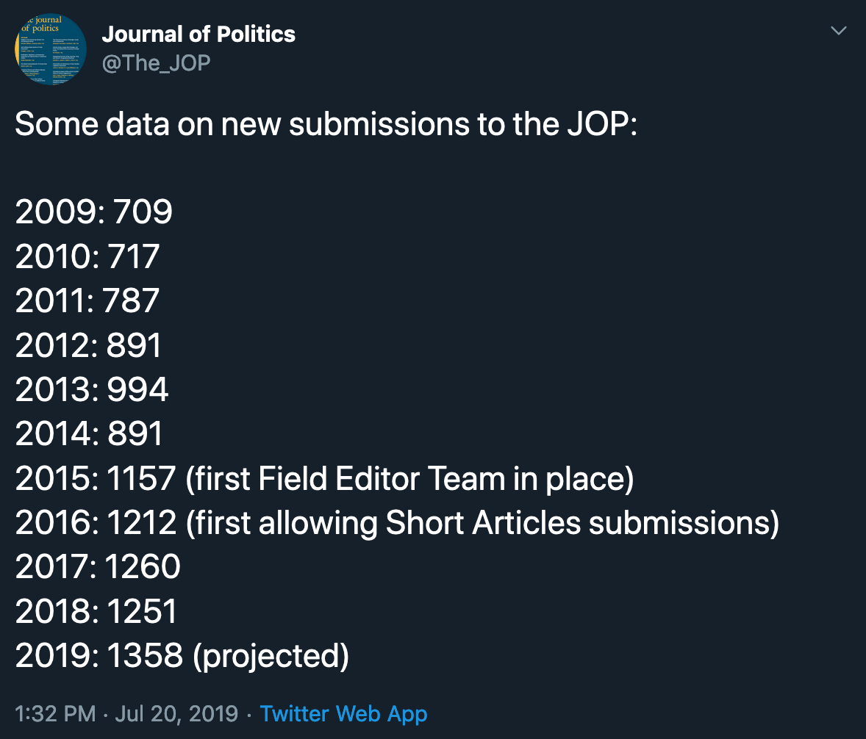
Notes:
https://twitter.com/The_JOP/status/1152632262896189441

Slide 5
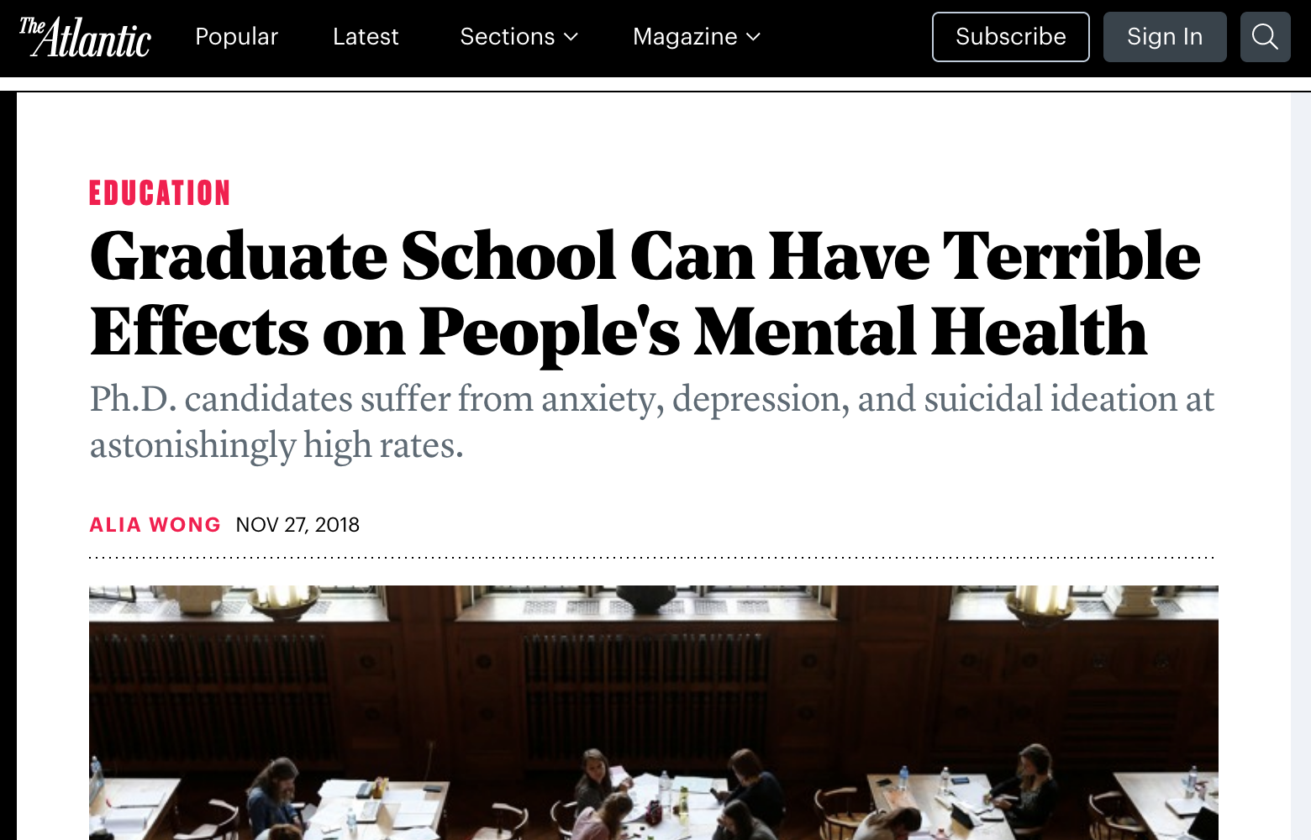
Notes:
https://www.theatlantic.com/education/archive/2018/11/anxiety-depression-mental-health-graduate-school/576769/

Slide 6
This sucks and shouldn’t be this way.
But existing institutional structures make it kinda inevitable ¯\_(ツ)_/¯

Slide 7
Embrace and normalize failure
Consider sharing and making your research process public

Slide 8
ACADEMIC MEANDERING

Slide 9
The Design Squiggle
The world sees this
Show people what this looks like
Notes:
My background – AUC and history failure – PMF and state department failure – job market failure

Slide 10
RADICAL TRANSPARENCY & PUBLIC WORK

Slide 11
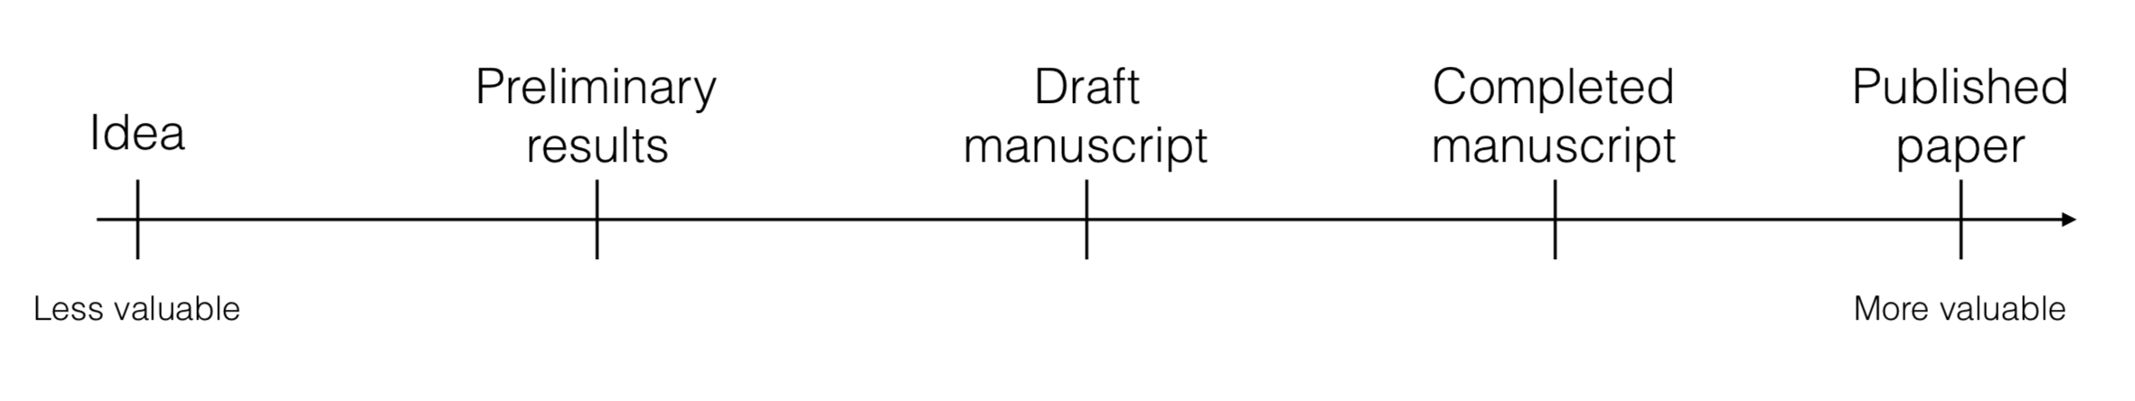
How we normally think of our work and goals

Slide 12
How do you learn R?
Find excuses to use it!
Dumb dinky projects
Data play time
Actual projects

Slide 13
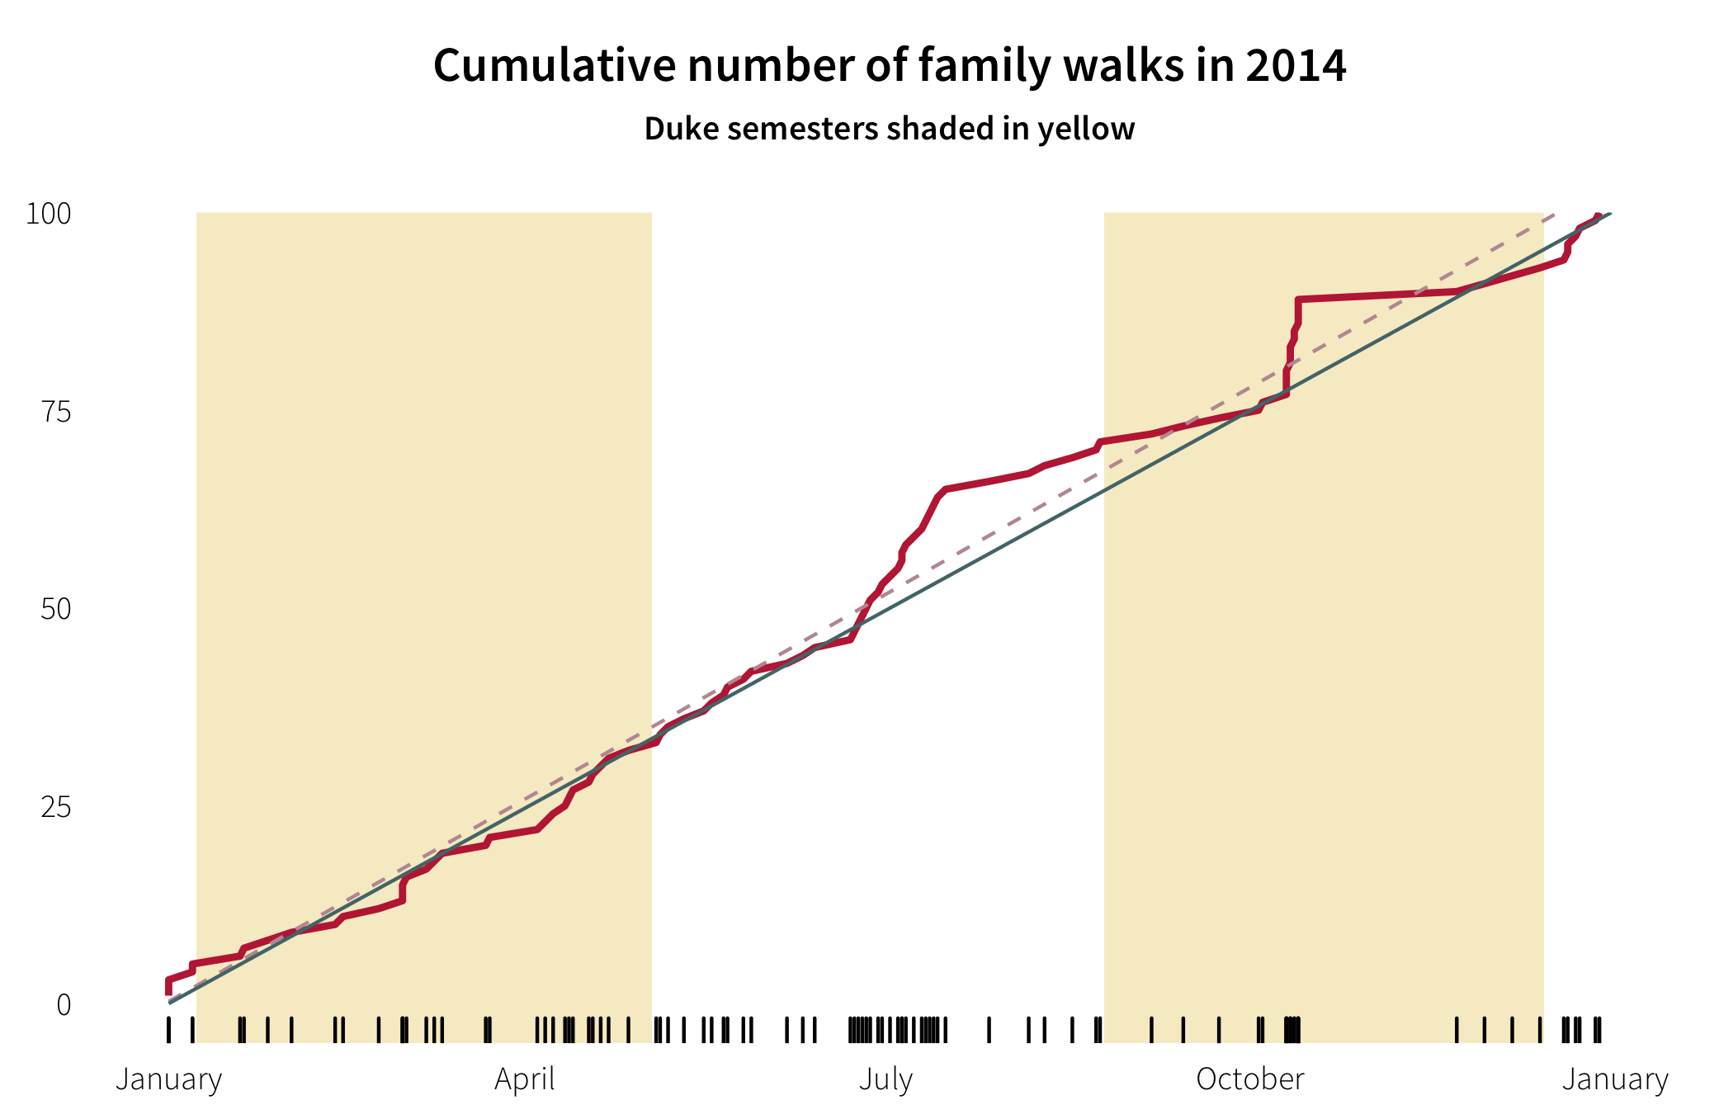
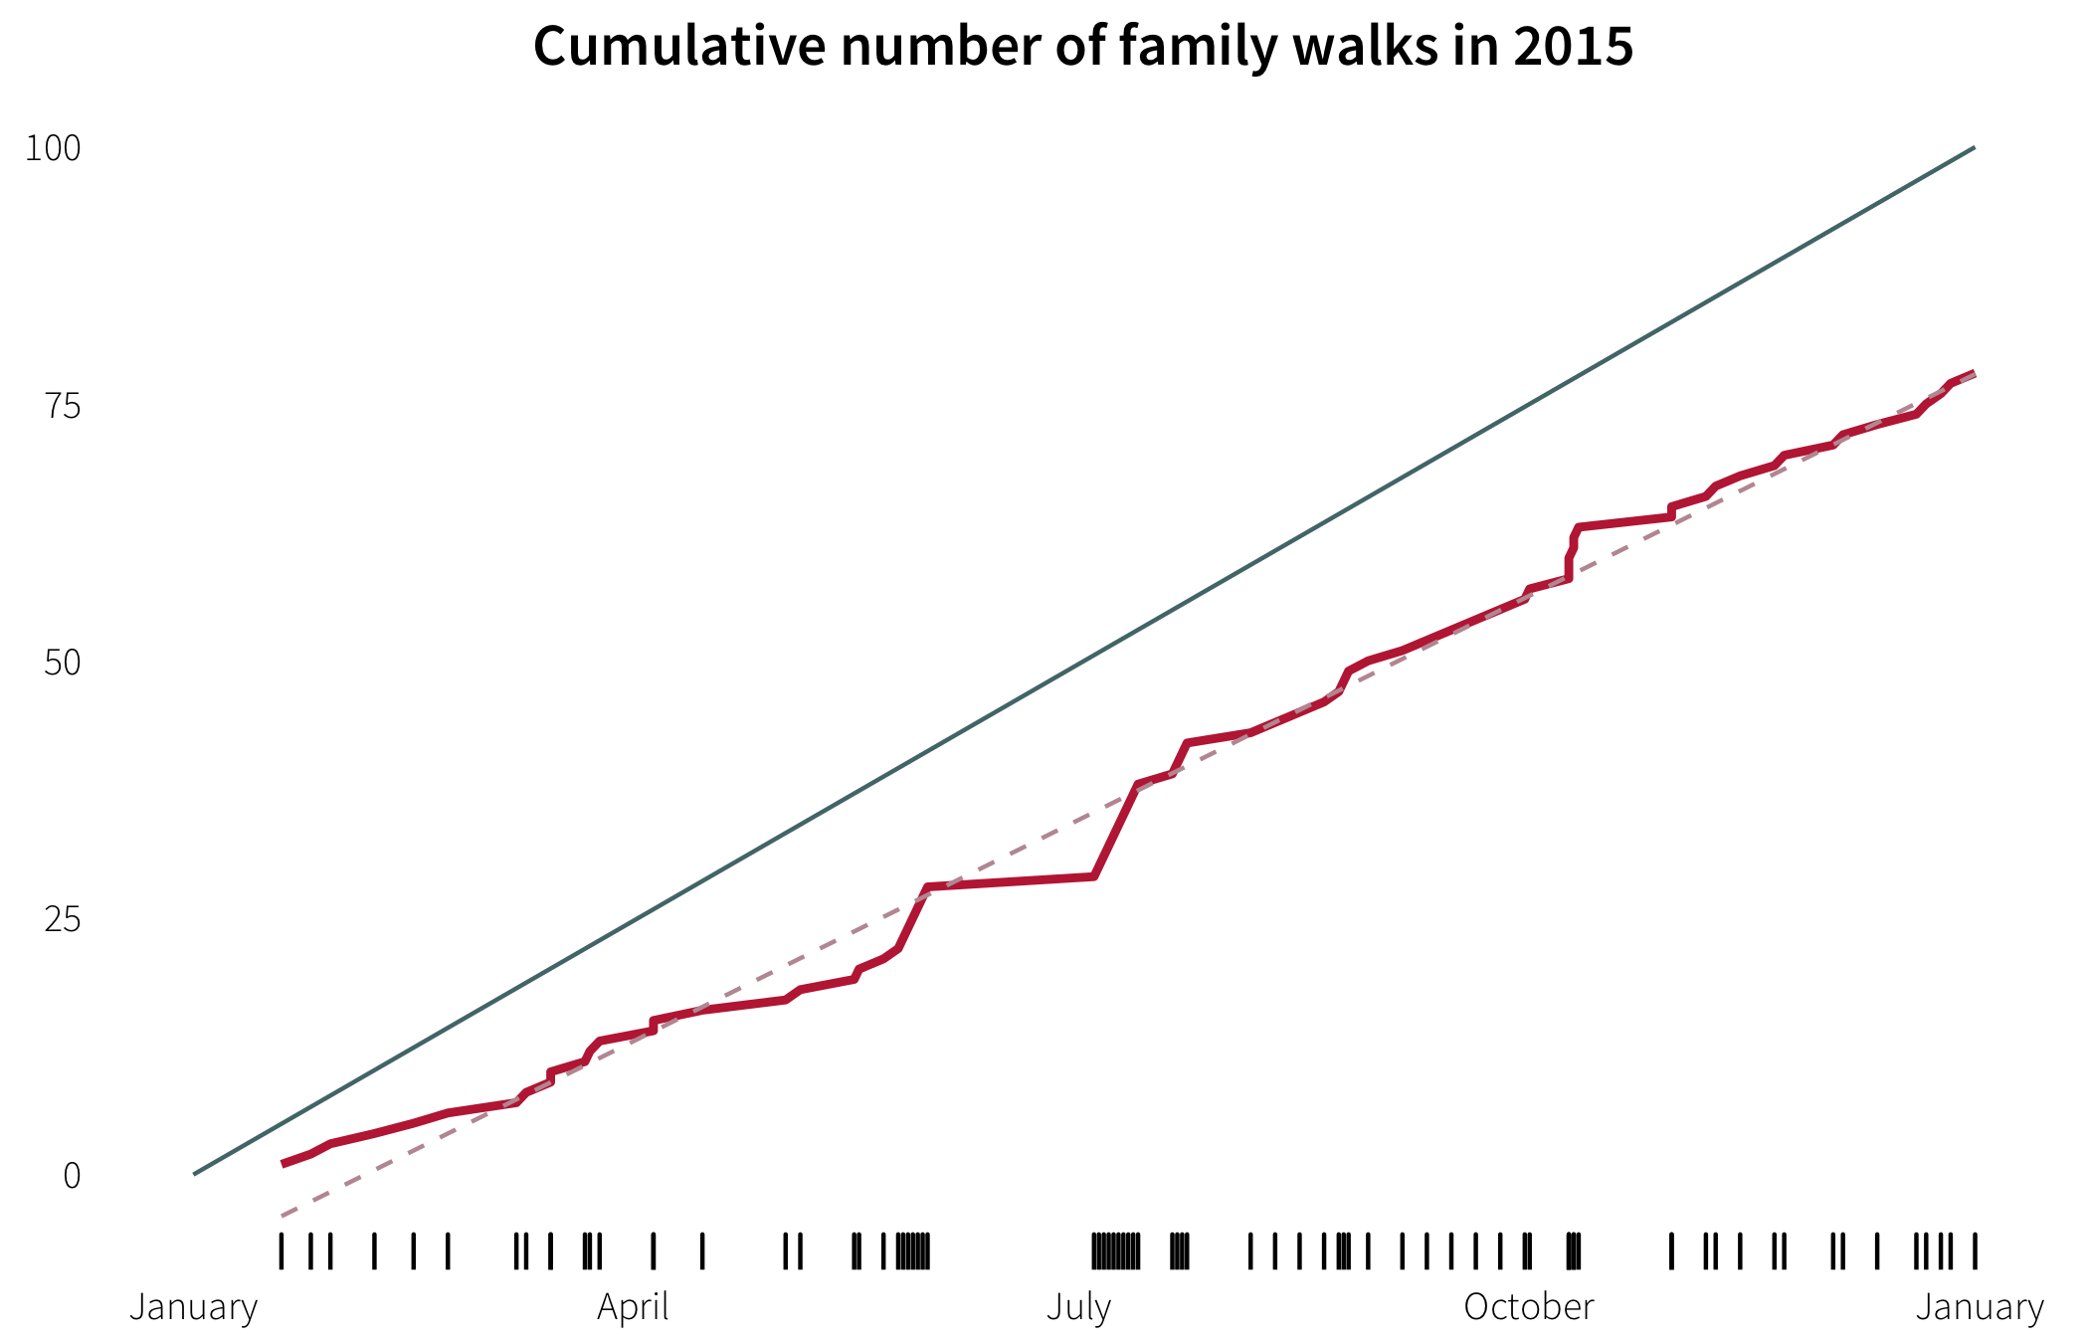

Slide 14
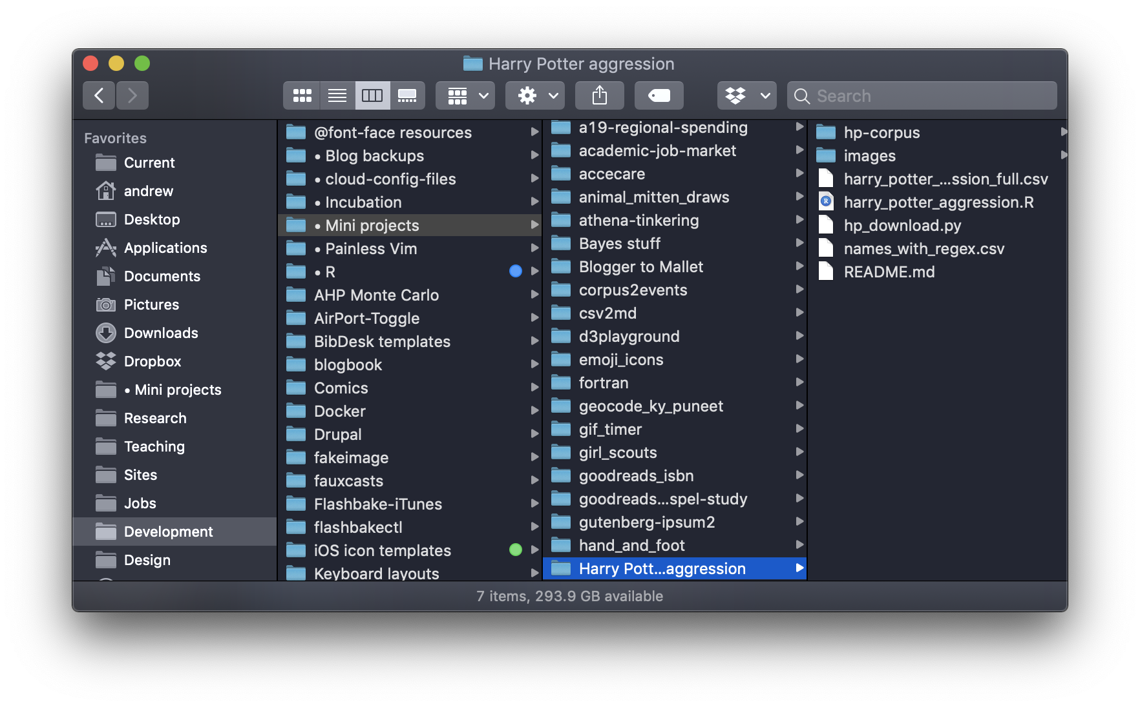

Slide 15
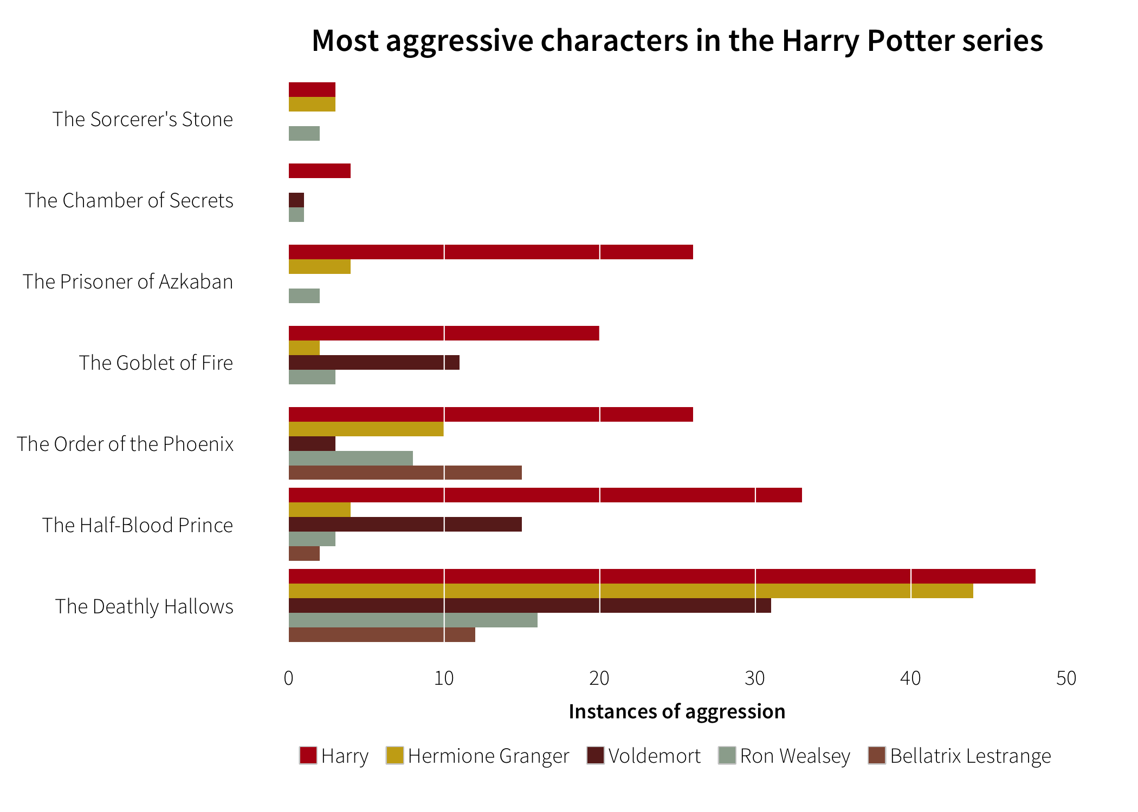

Slide 16
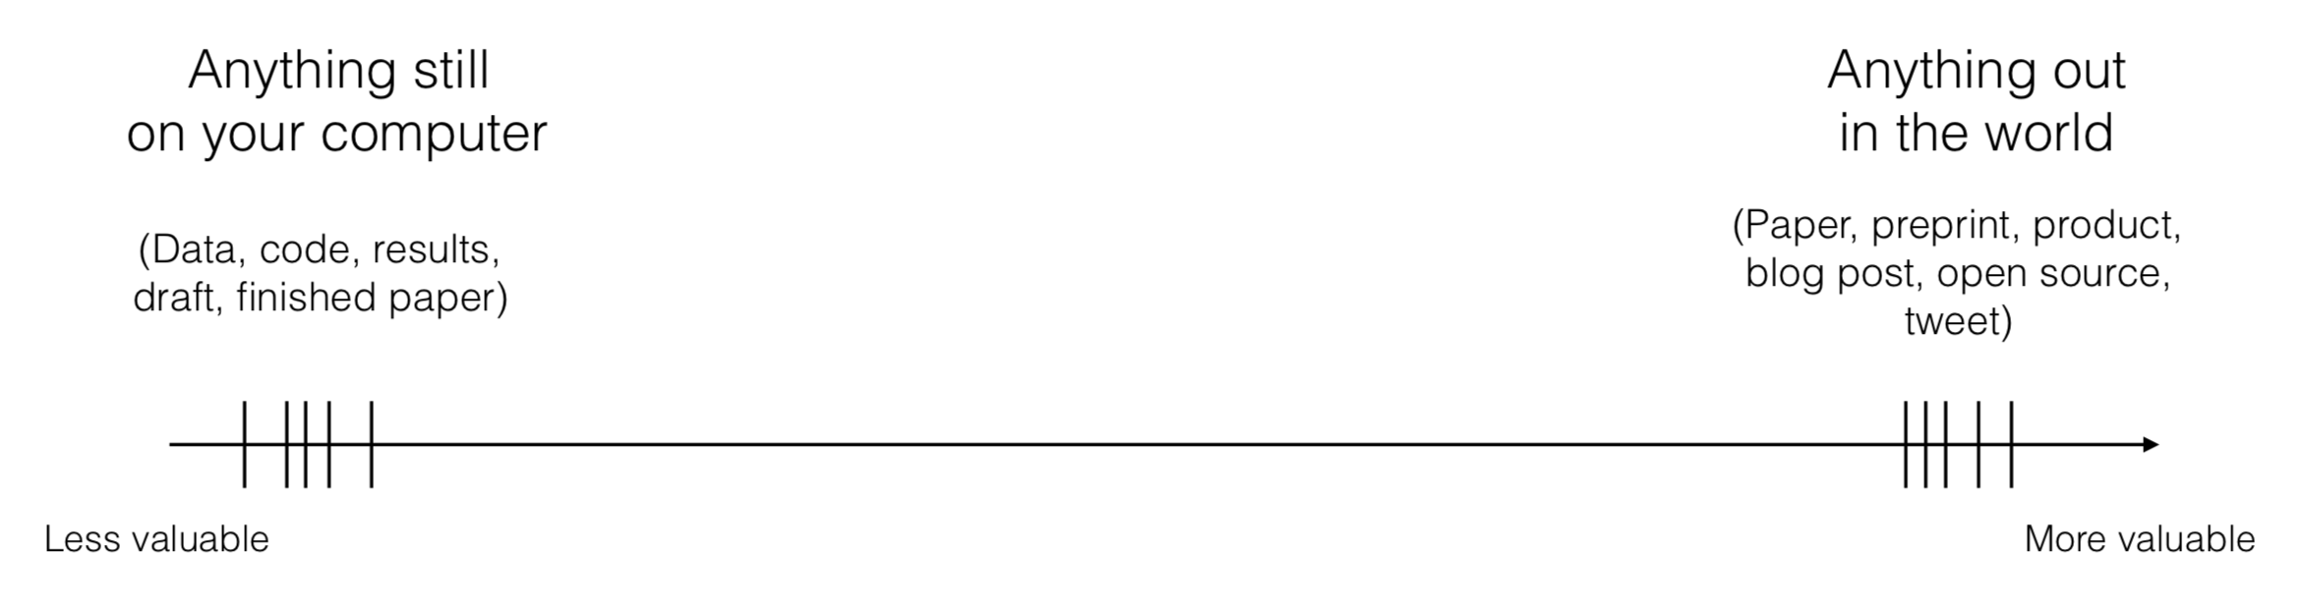
How we should think of our work and goals

Slide 17
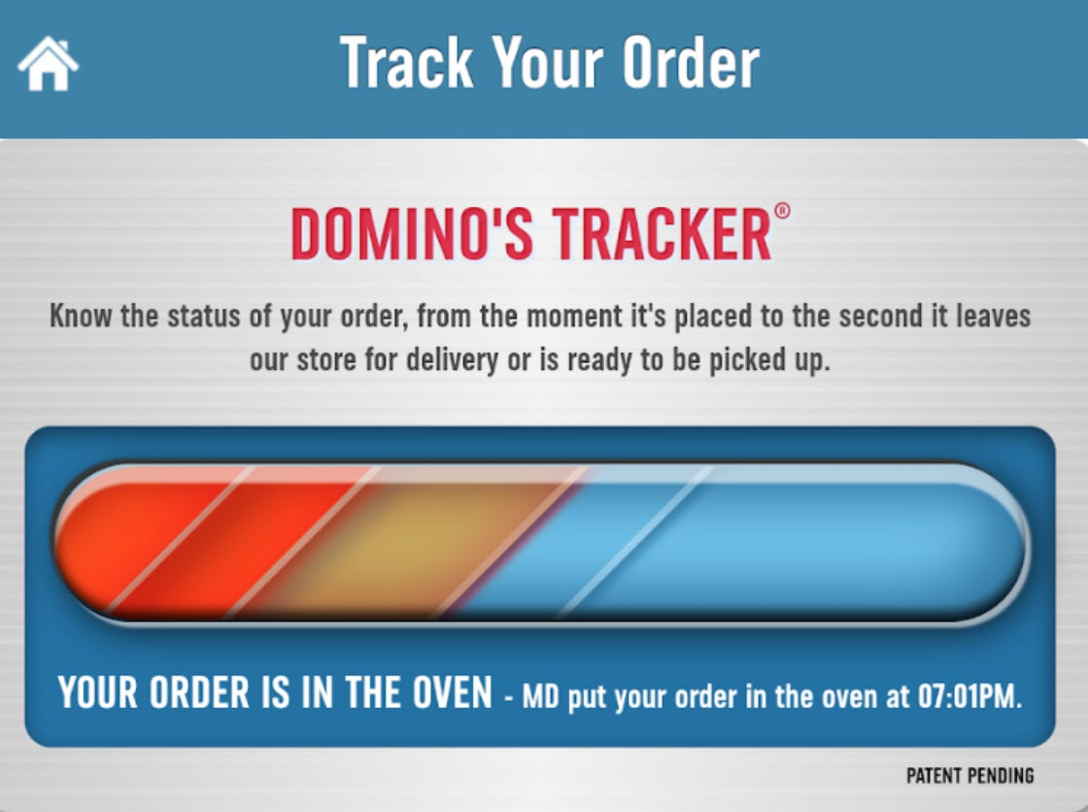
Notes:
https://99percentinvisible.org/episode/wait-wait-tell-me/

Slide 18
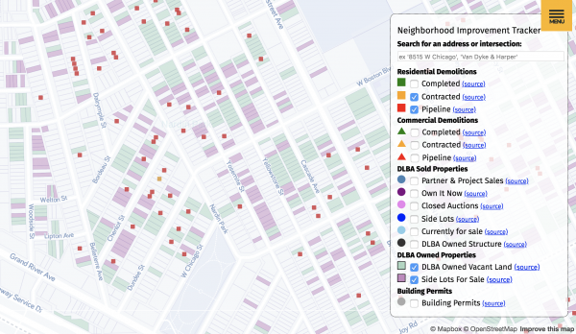
Notes:
https://99percentinvisible.org/episode/wait-wait-tell-me/

Slide 19
Benefits of working in public
Build reputation
Learn more
Grow community
Early feedback on ideas
Validation
Normalization of failure

Slide 21
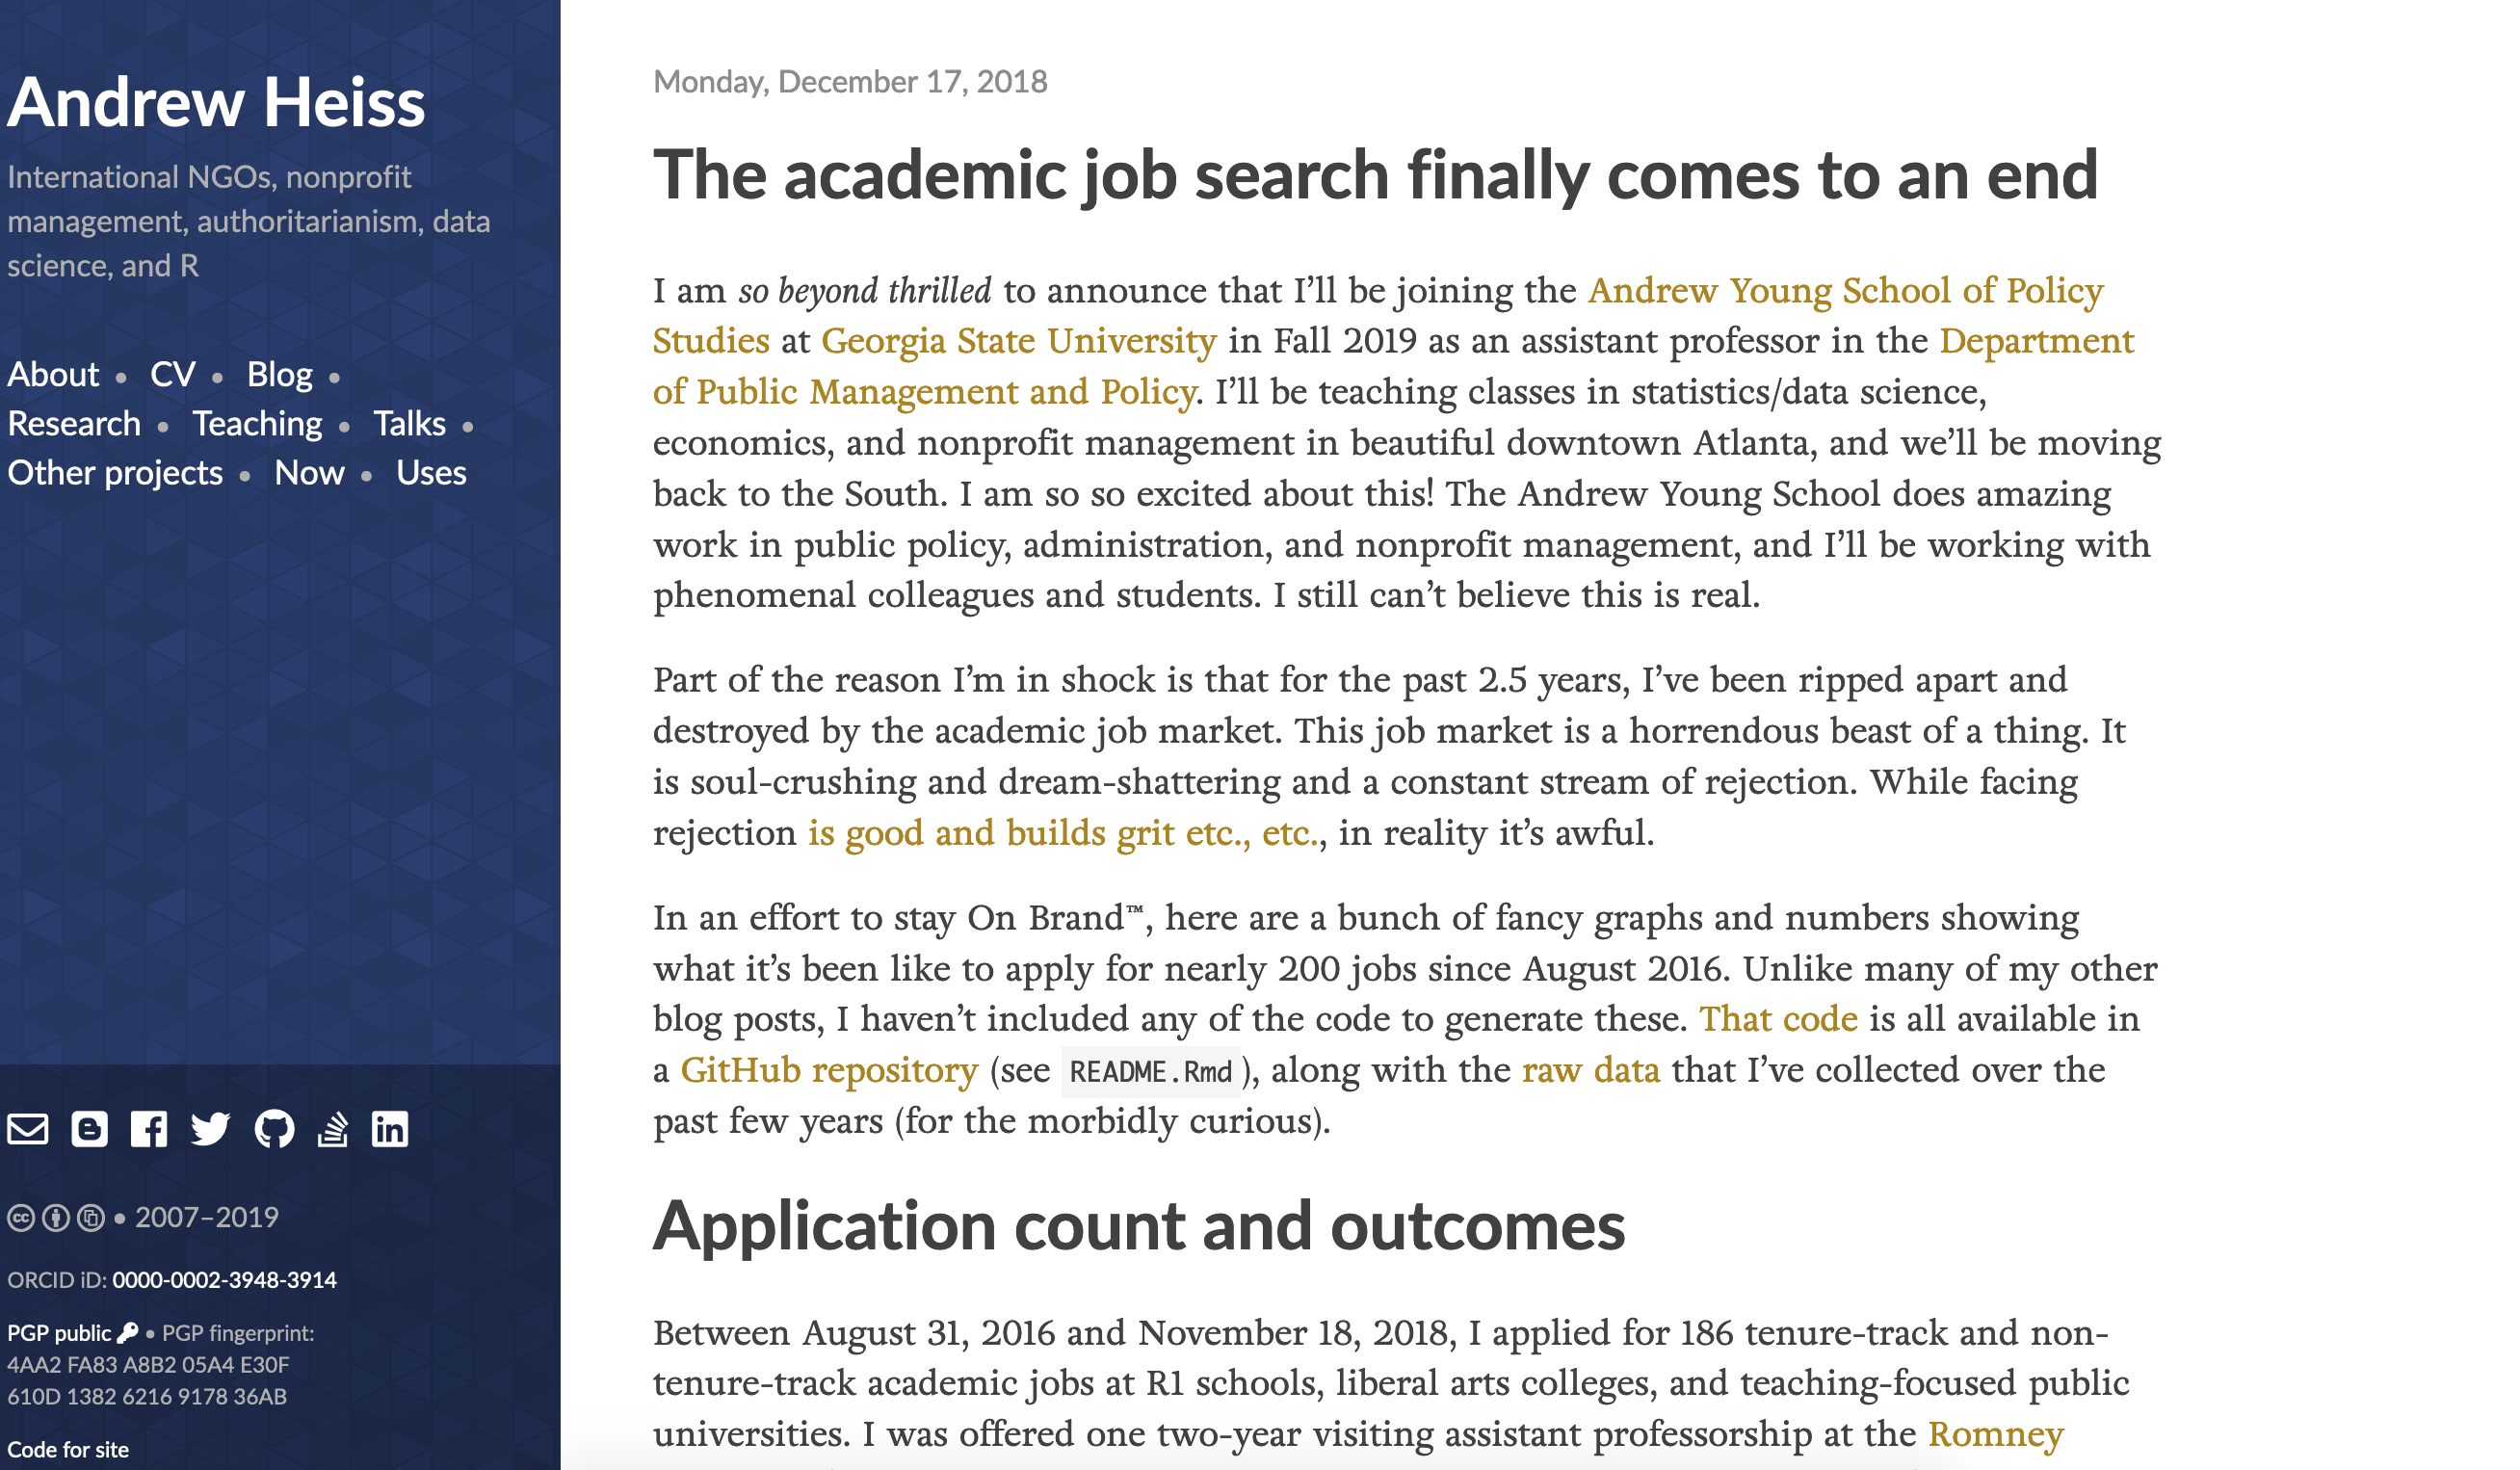

Slide 22
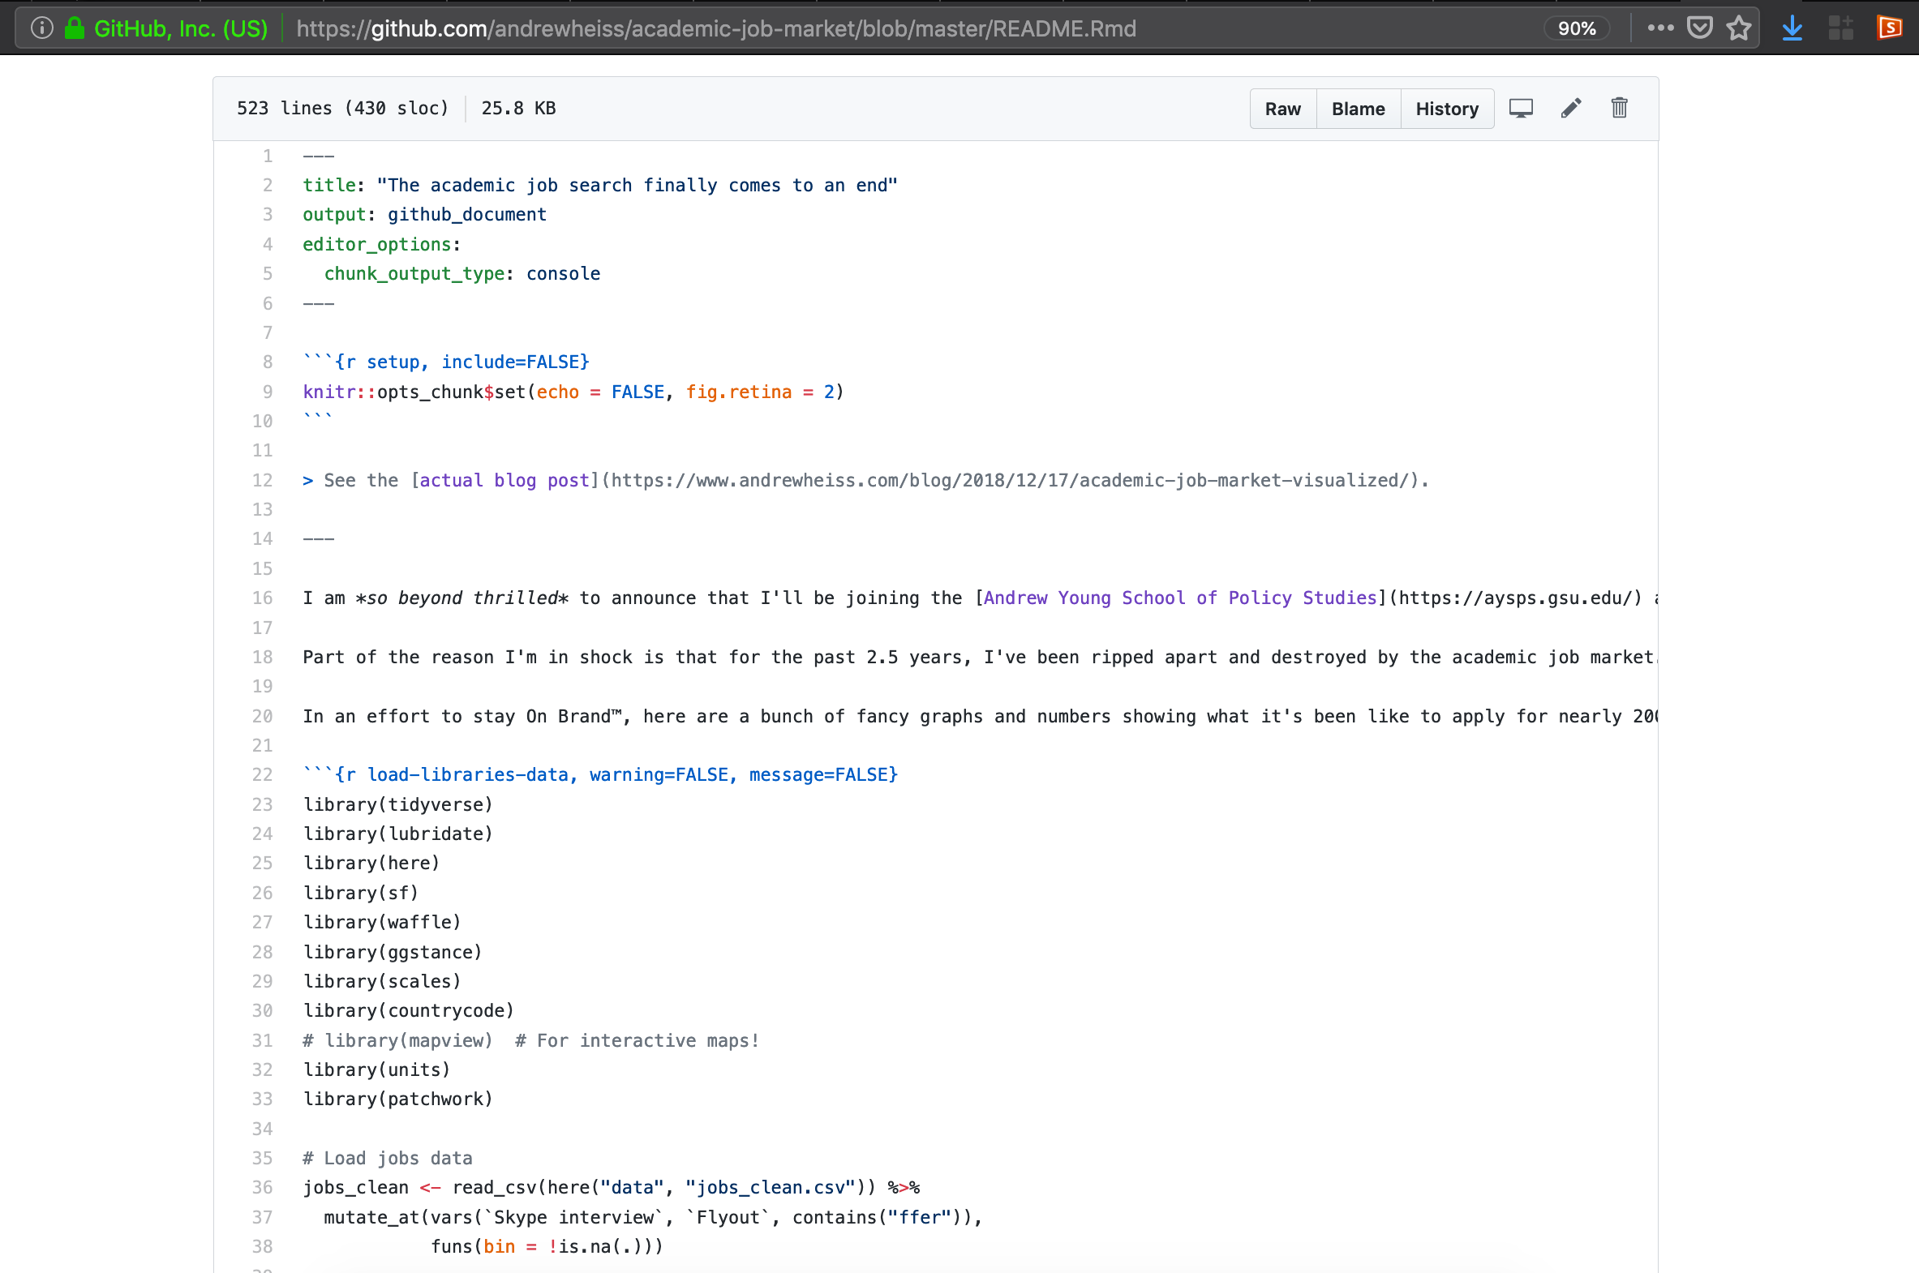

Slide 23
How to work in public
Blog and tweet
Analyze data
Blog about research
Teach concepts
Make research public

Slide 24

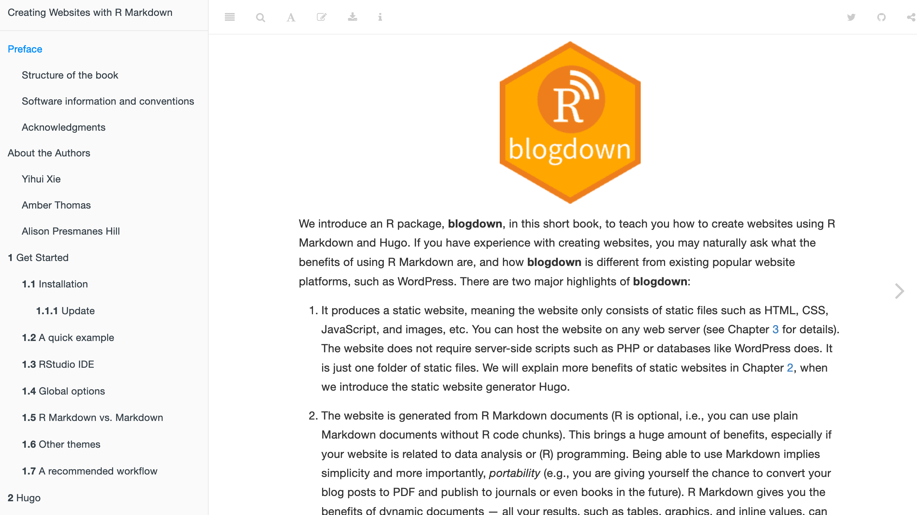
Start a blog

Slide 25
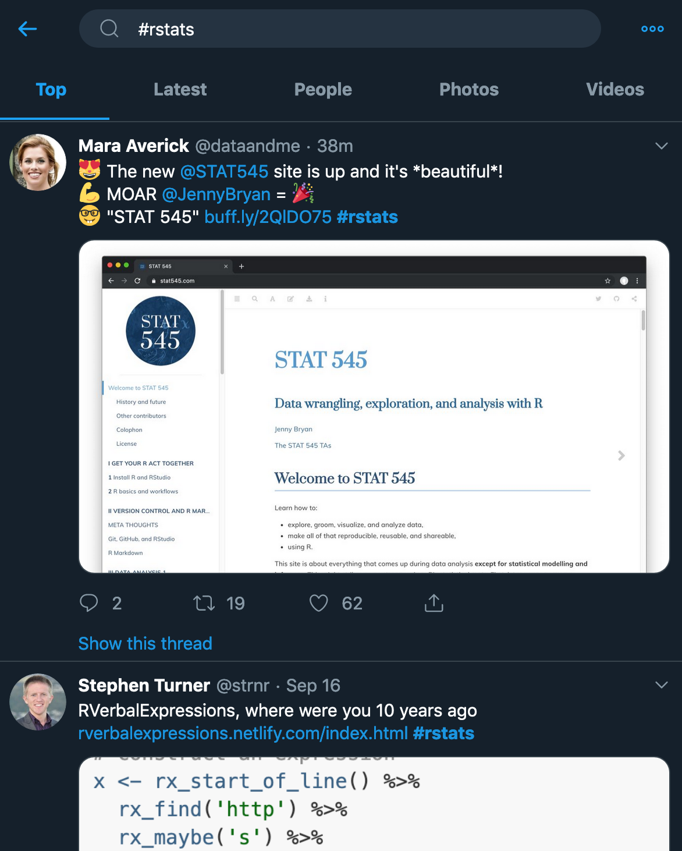
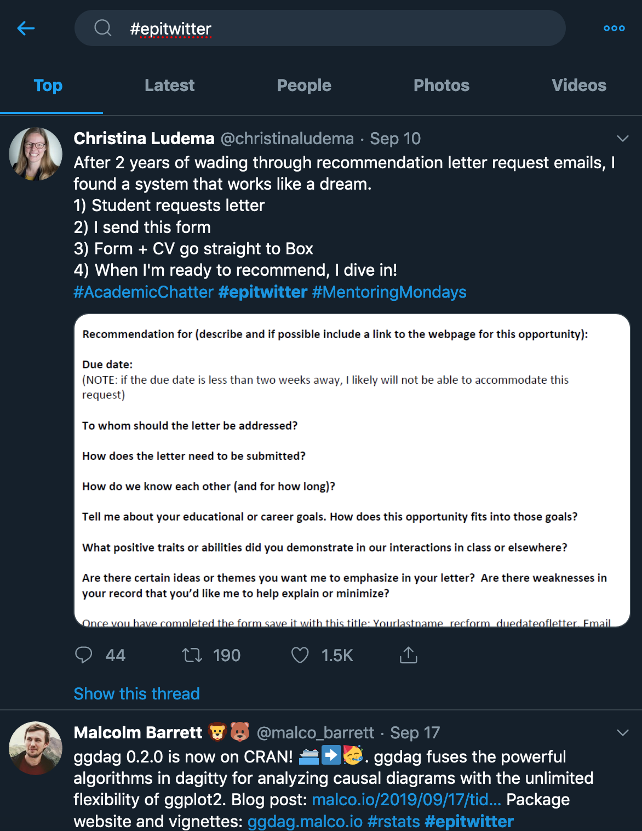
Finding online communities

Slide 26
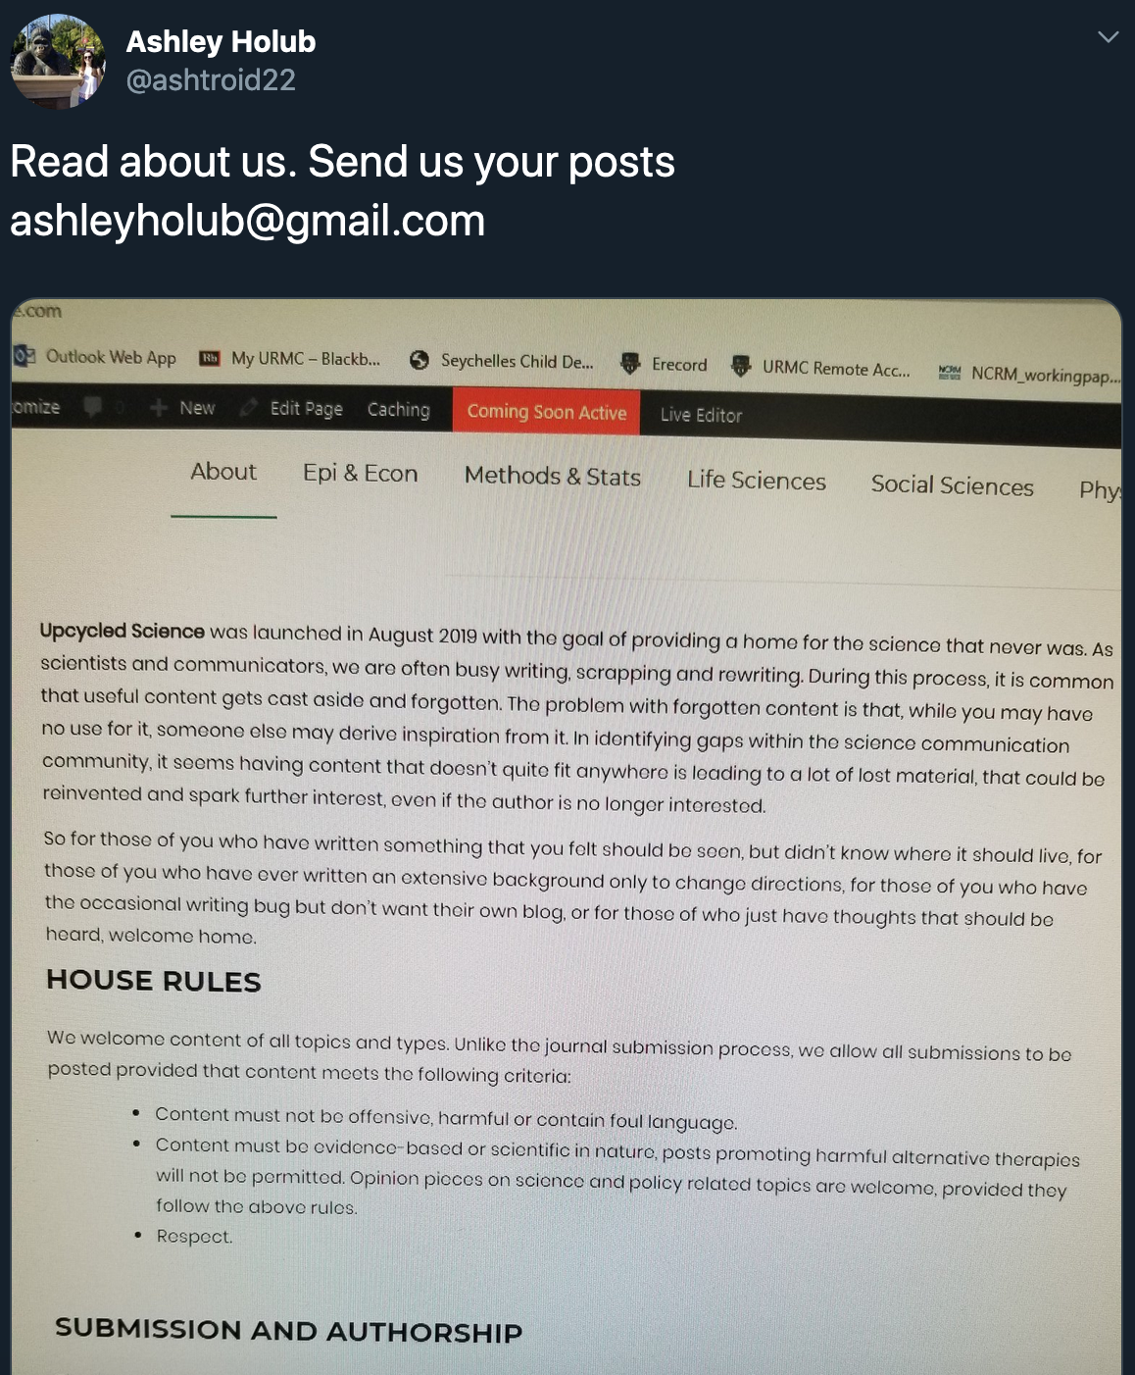

Slide 27
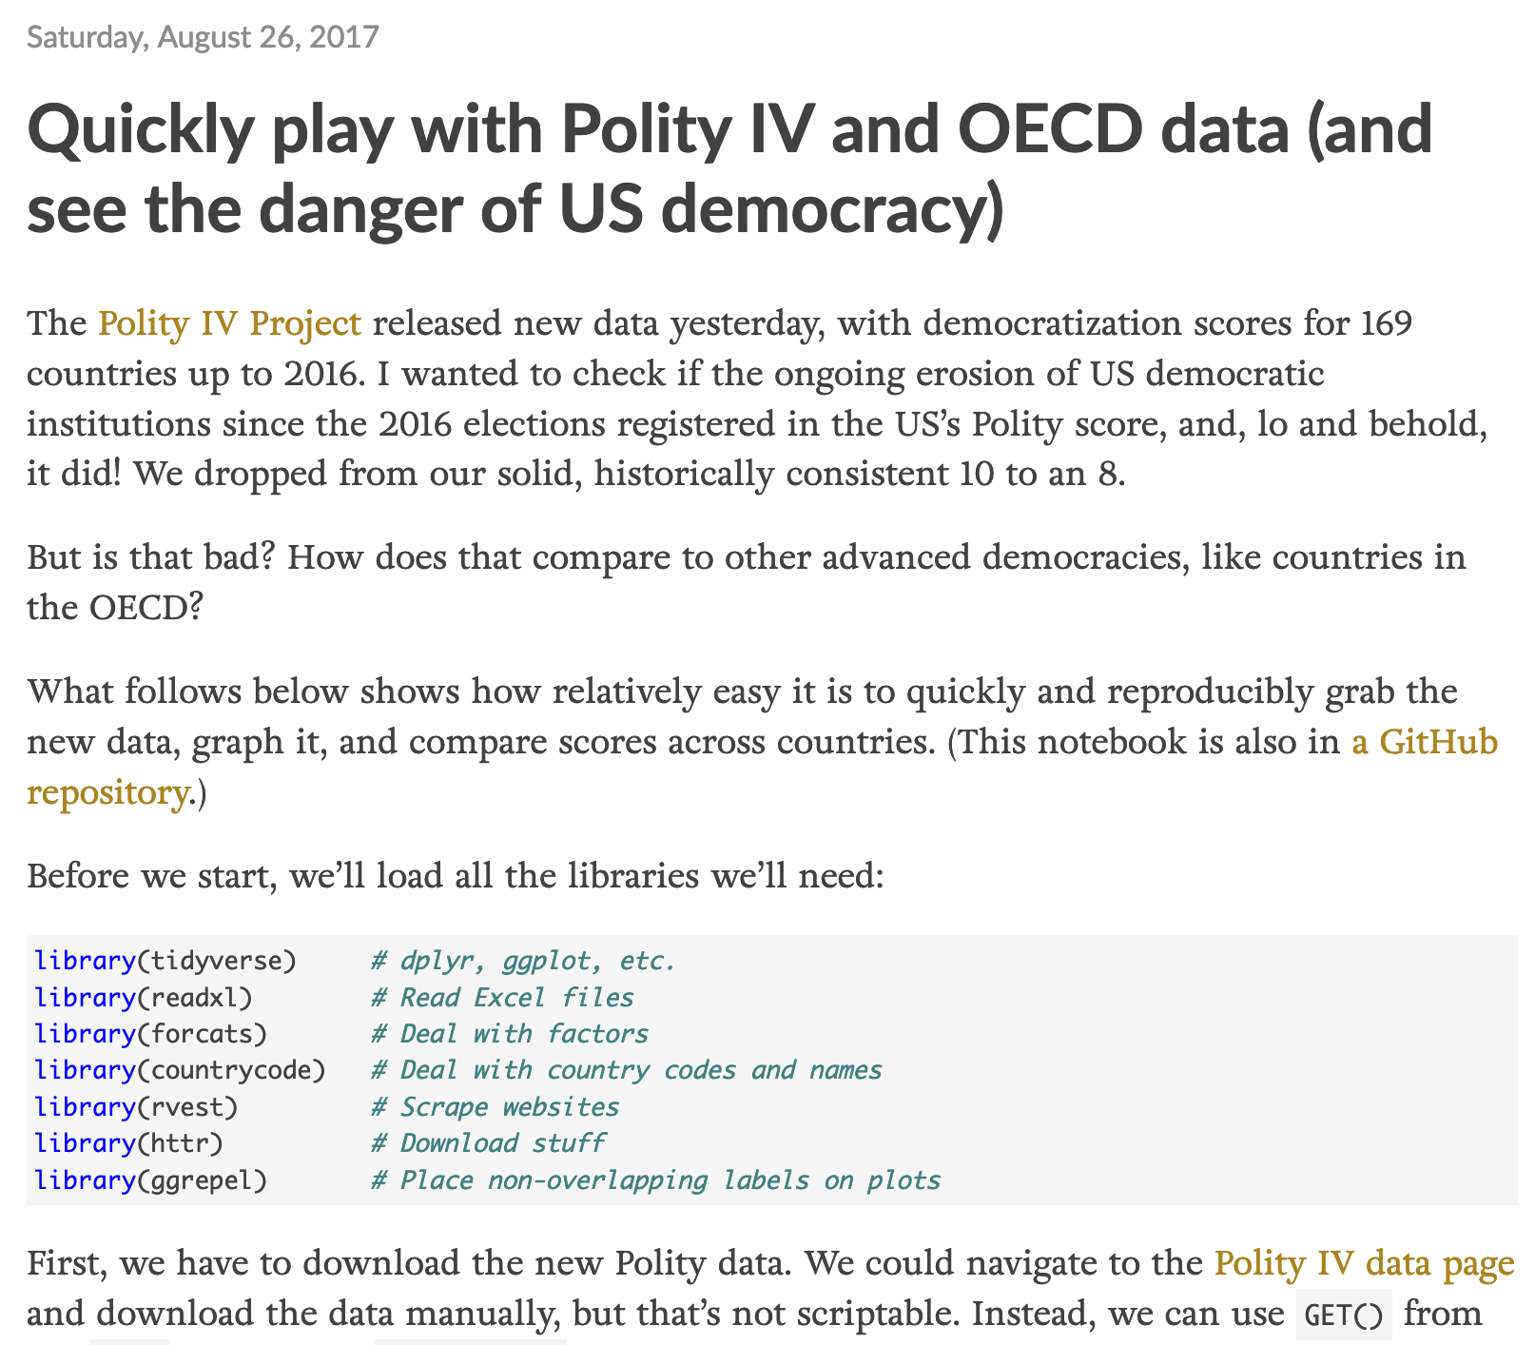
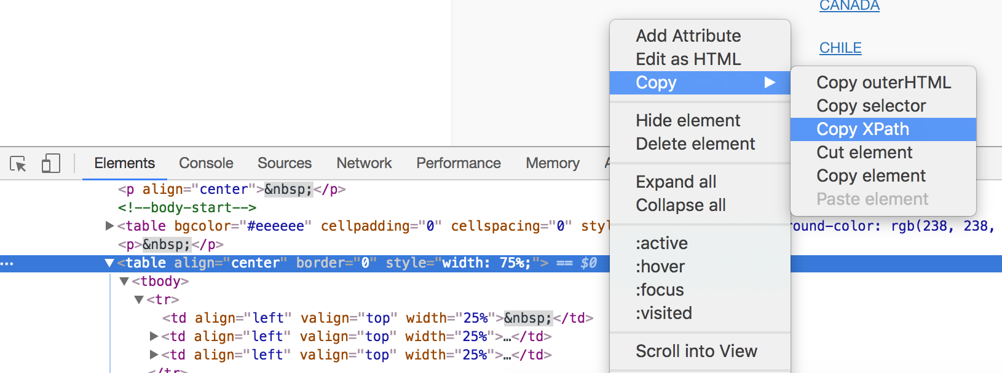
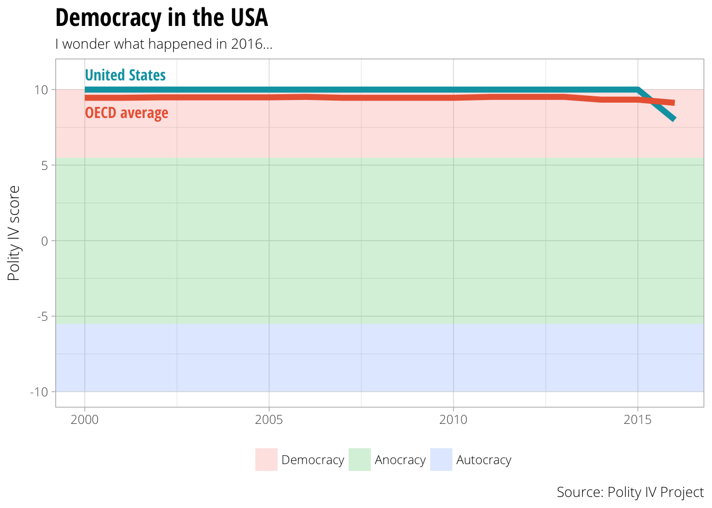
Analyze data

Slide 28
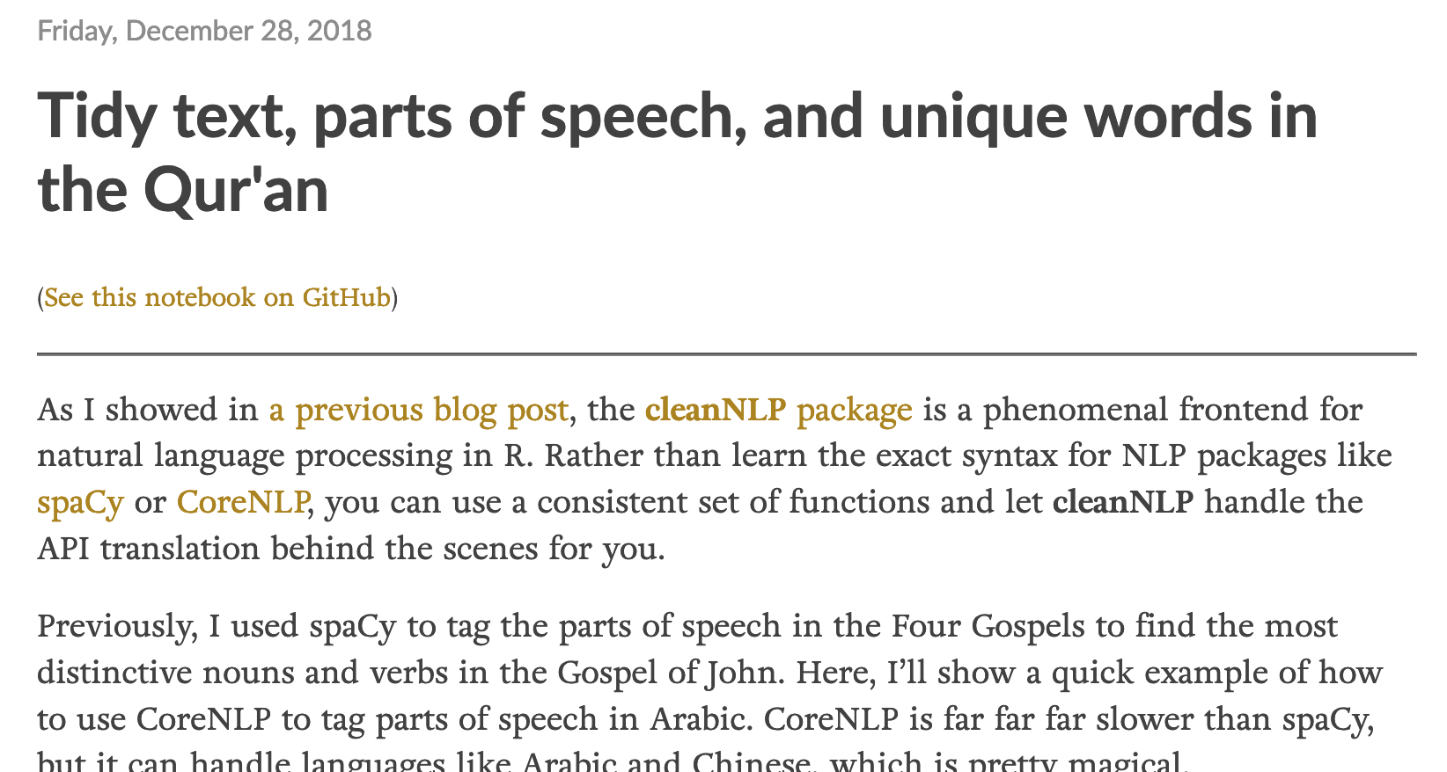
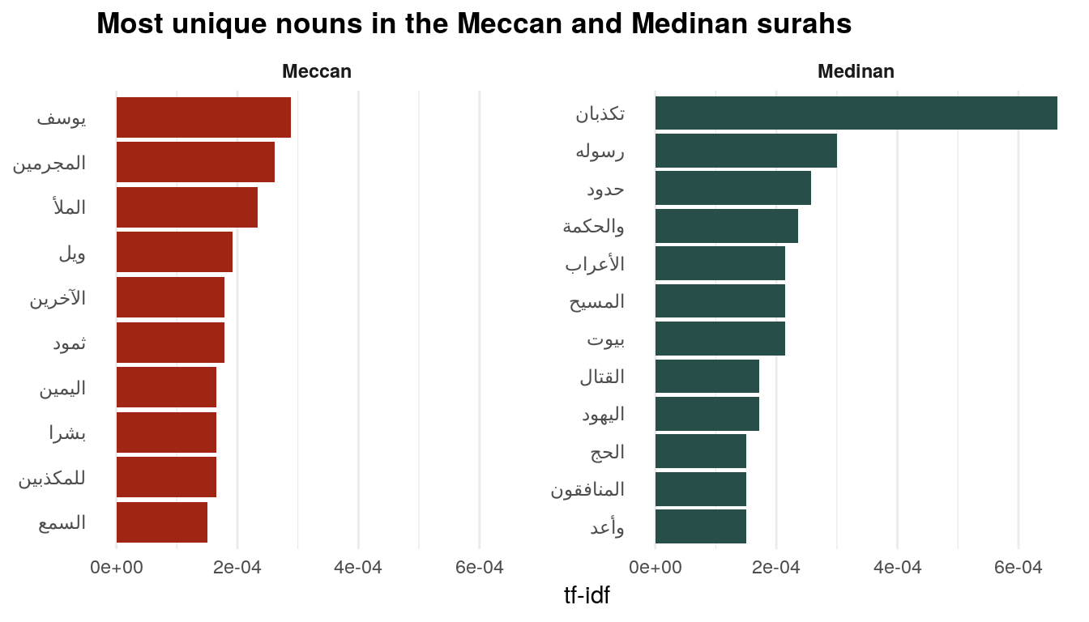
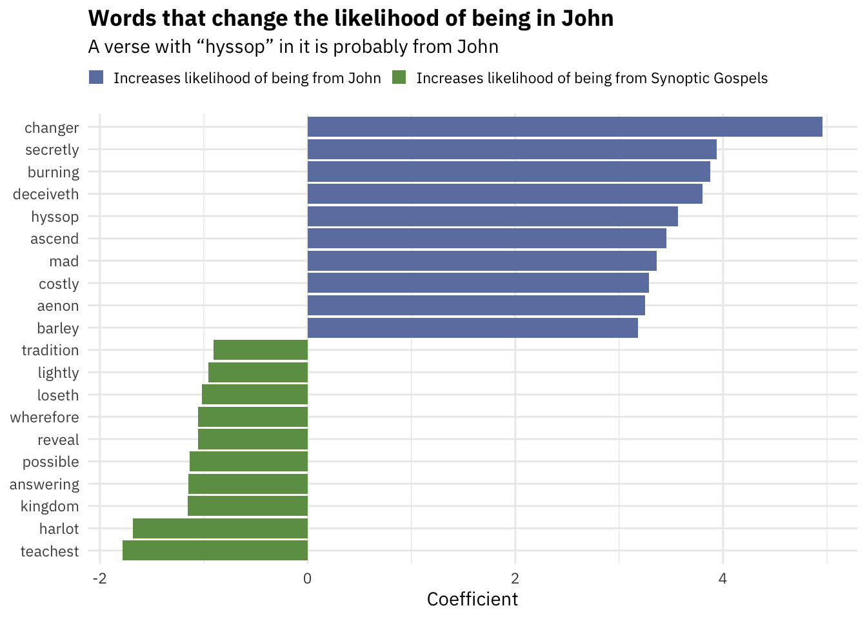


Slide 29
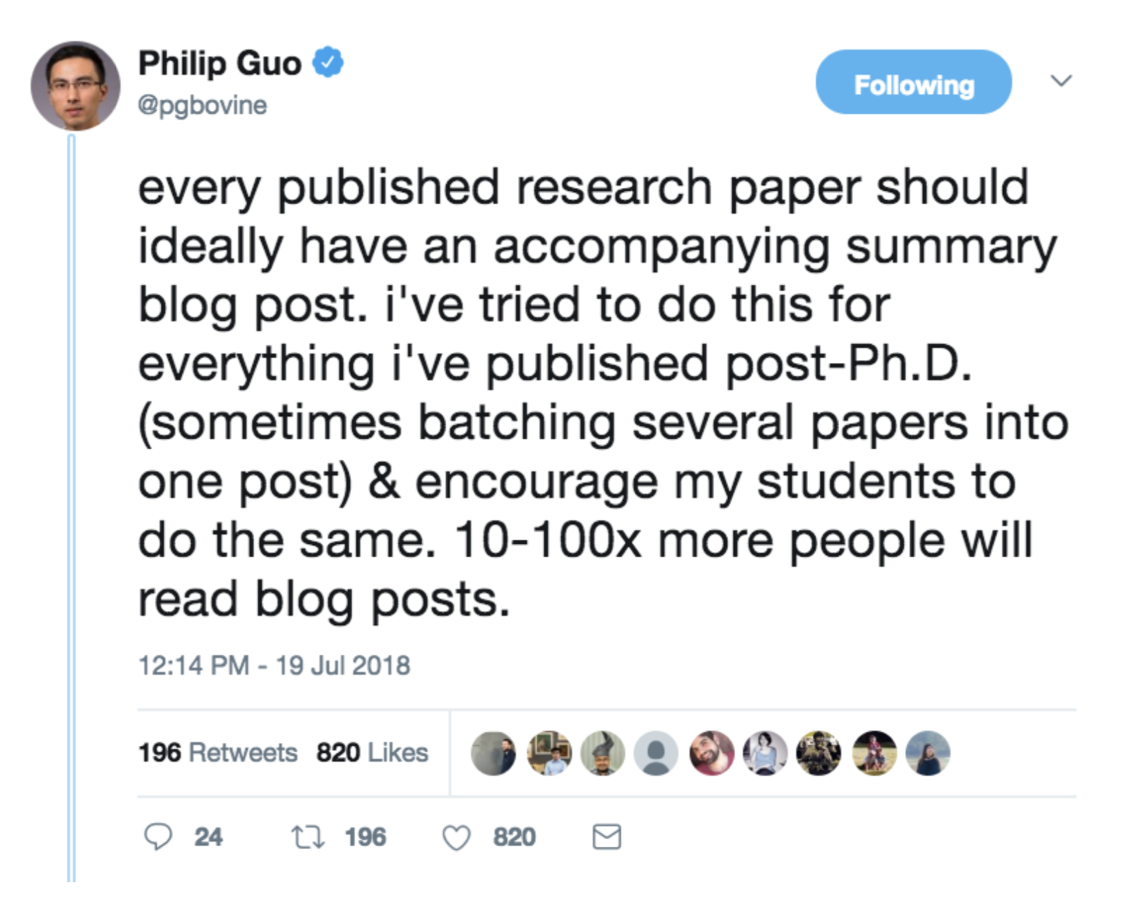
Blog about research

Slide 30
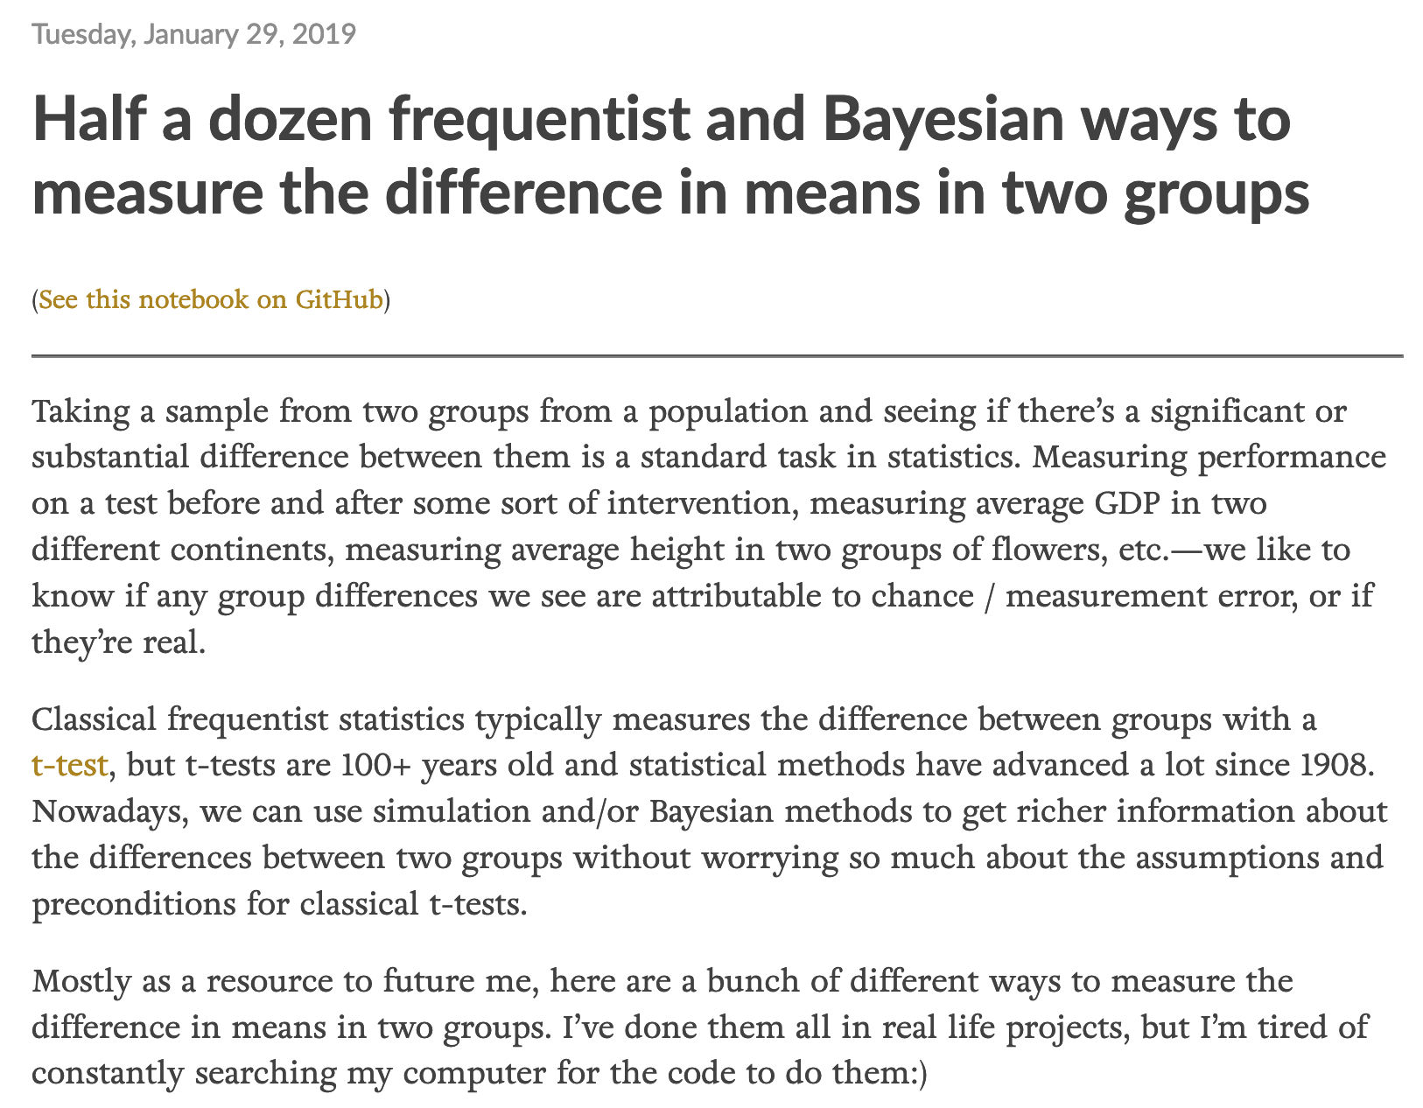
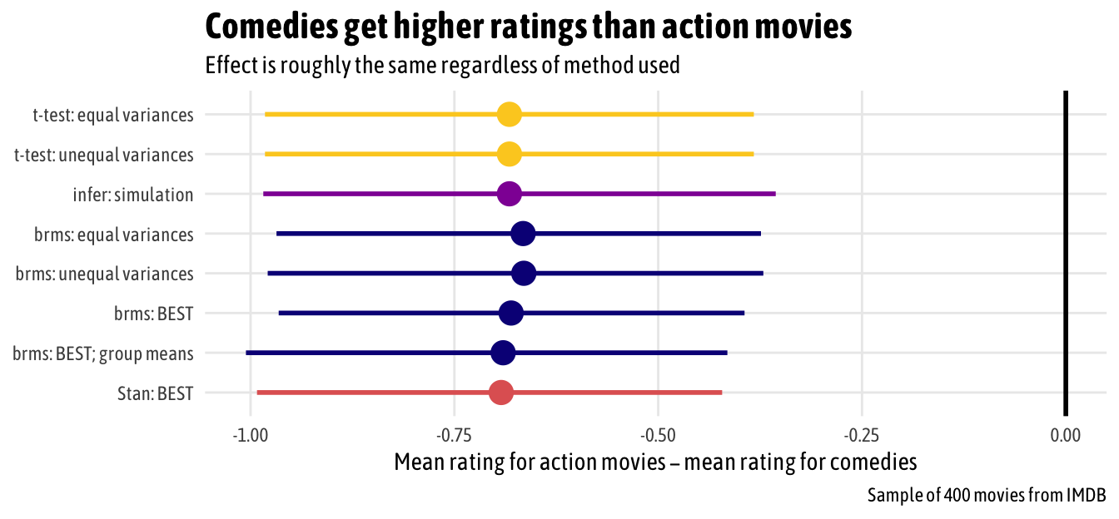
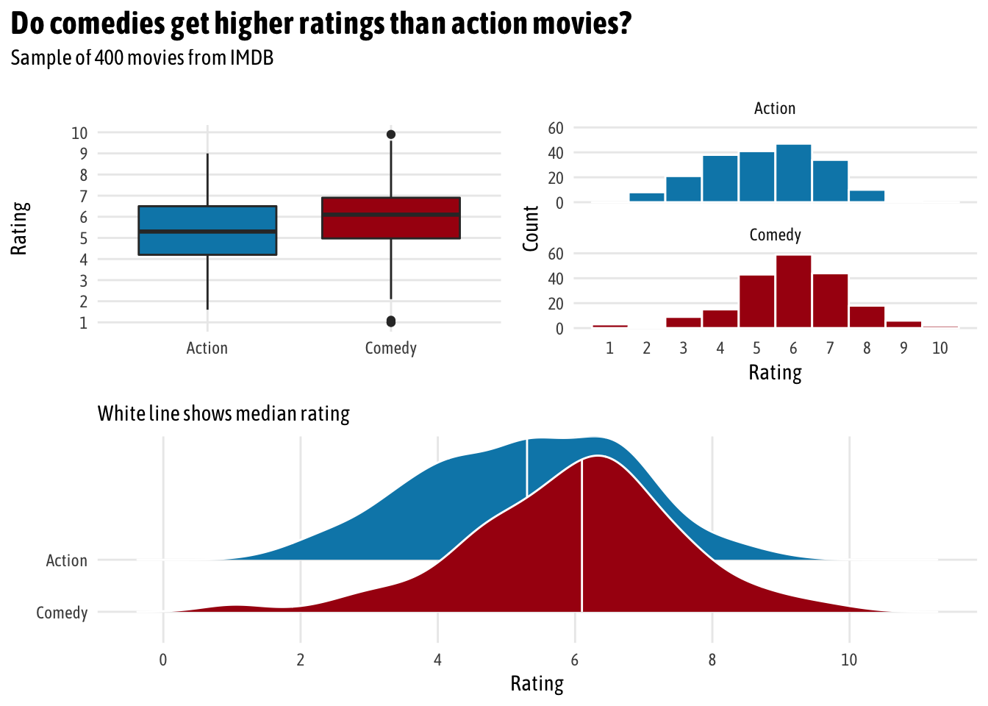
Teach a concept

Slide 31
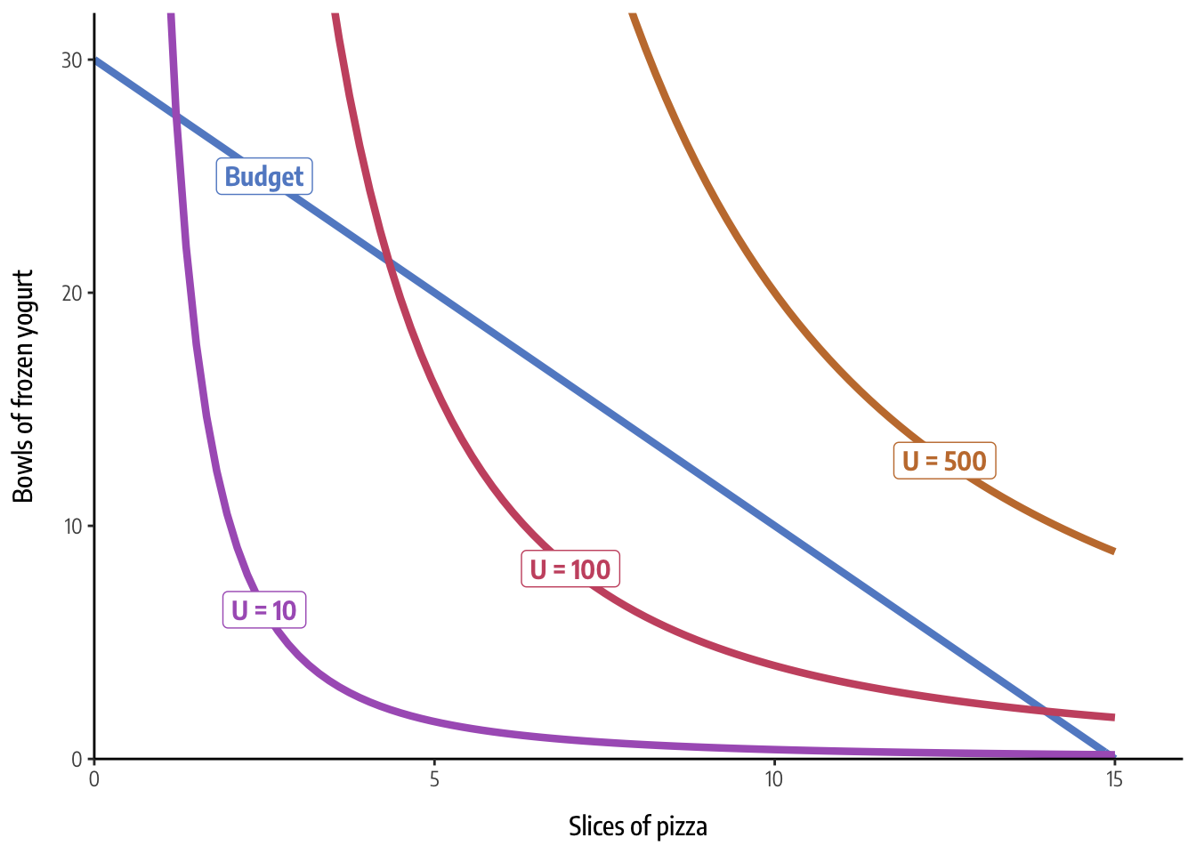

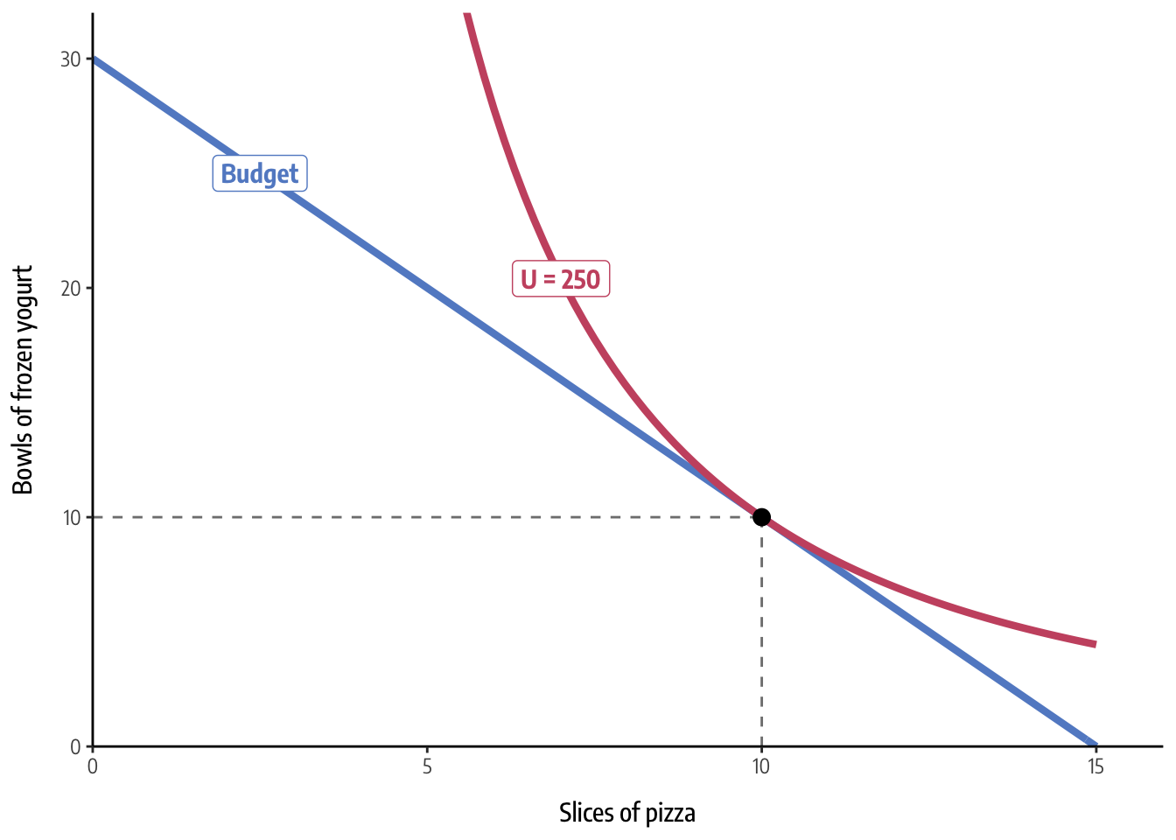

Slide 32
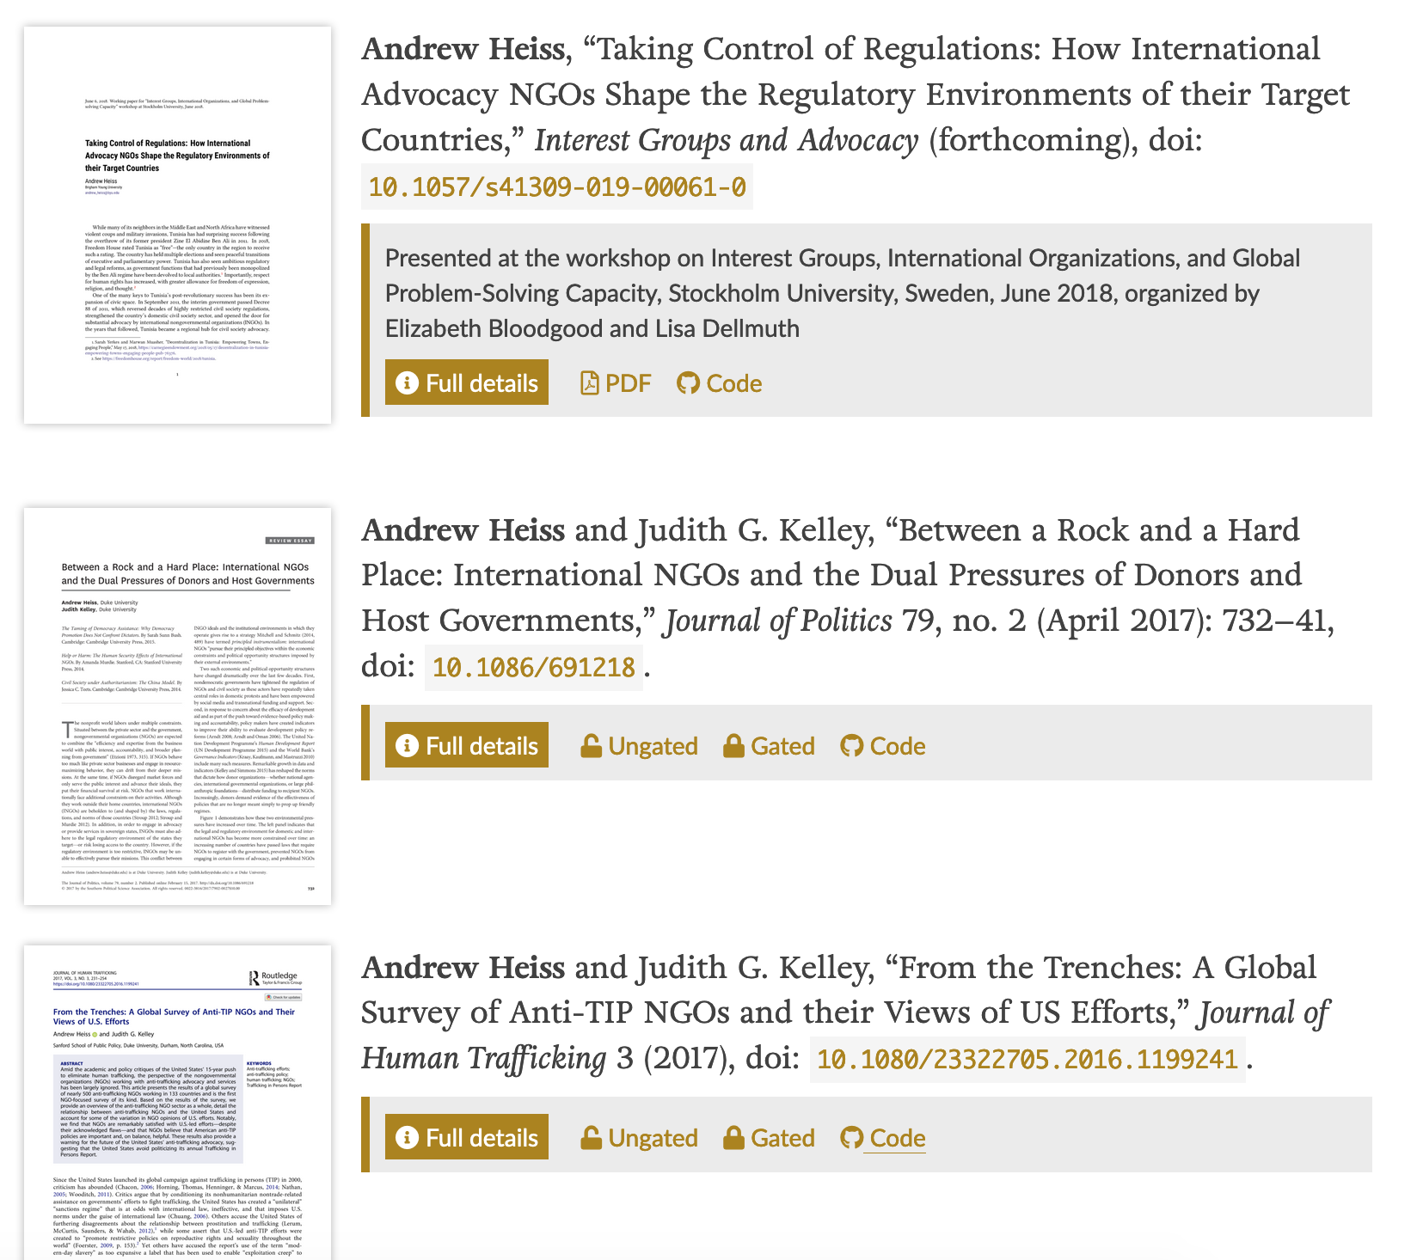
Make research public

Slide 33
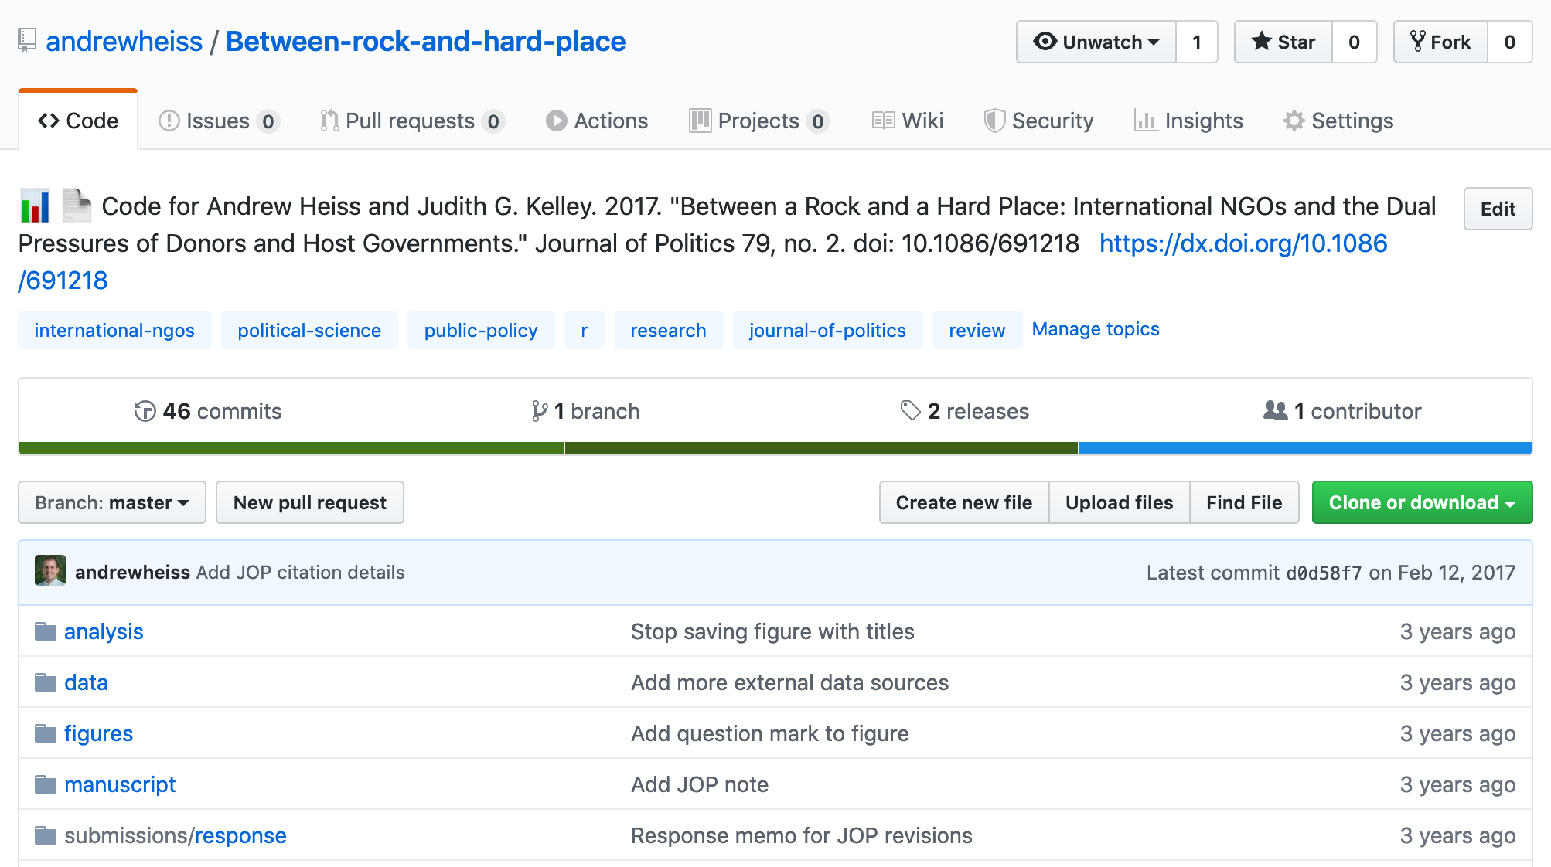
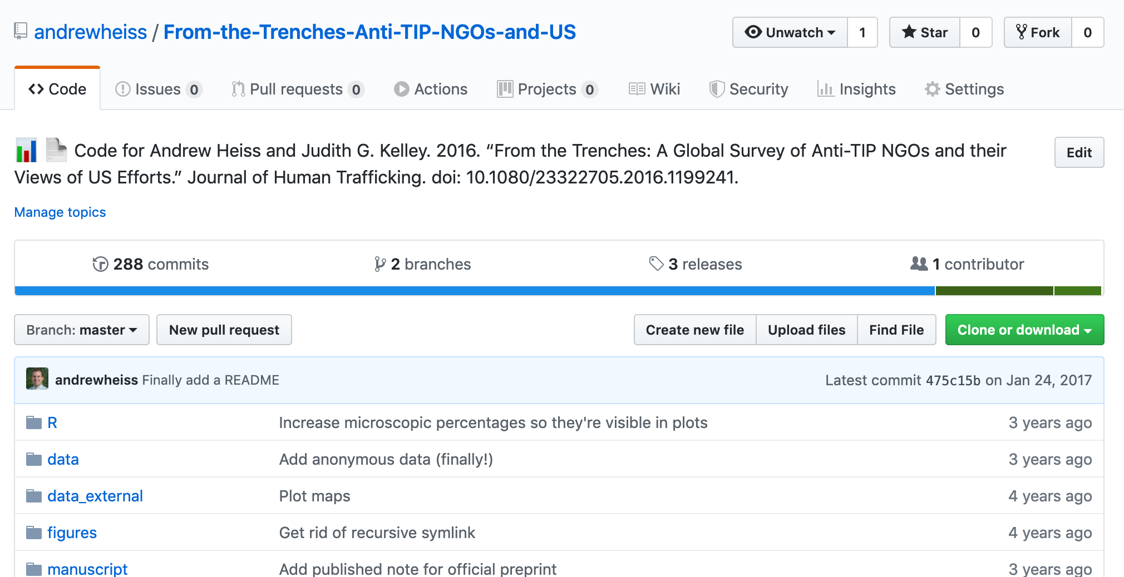
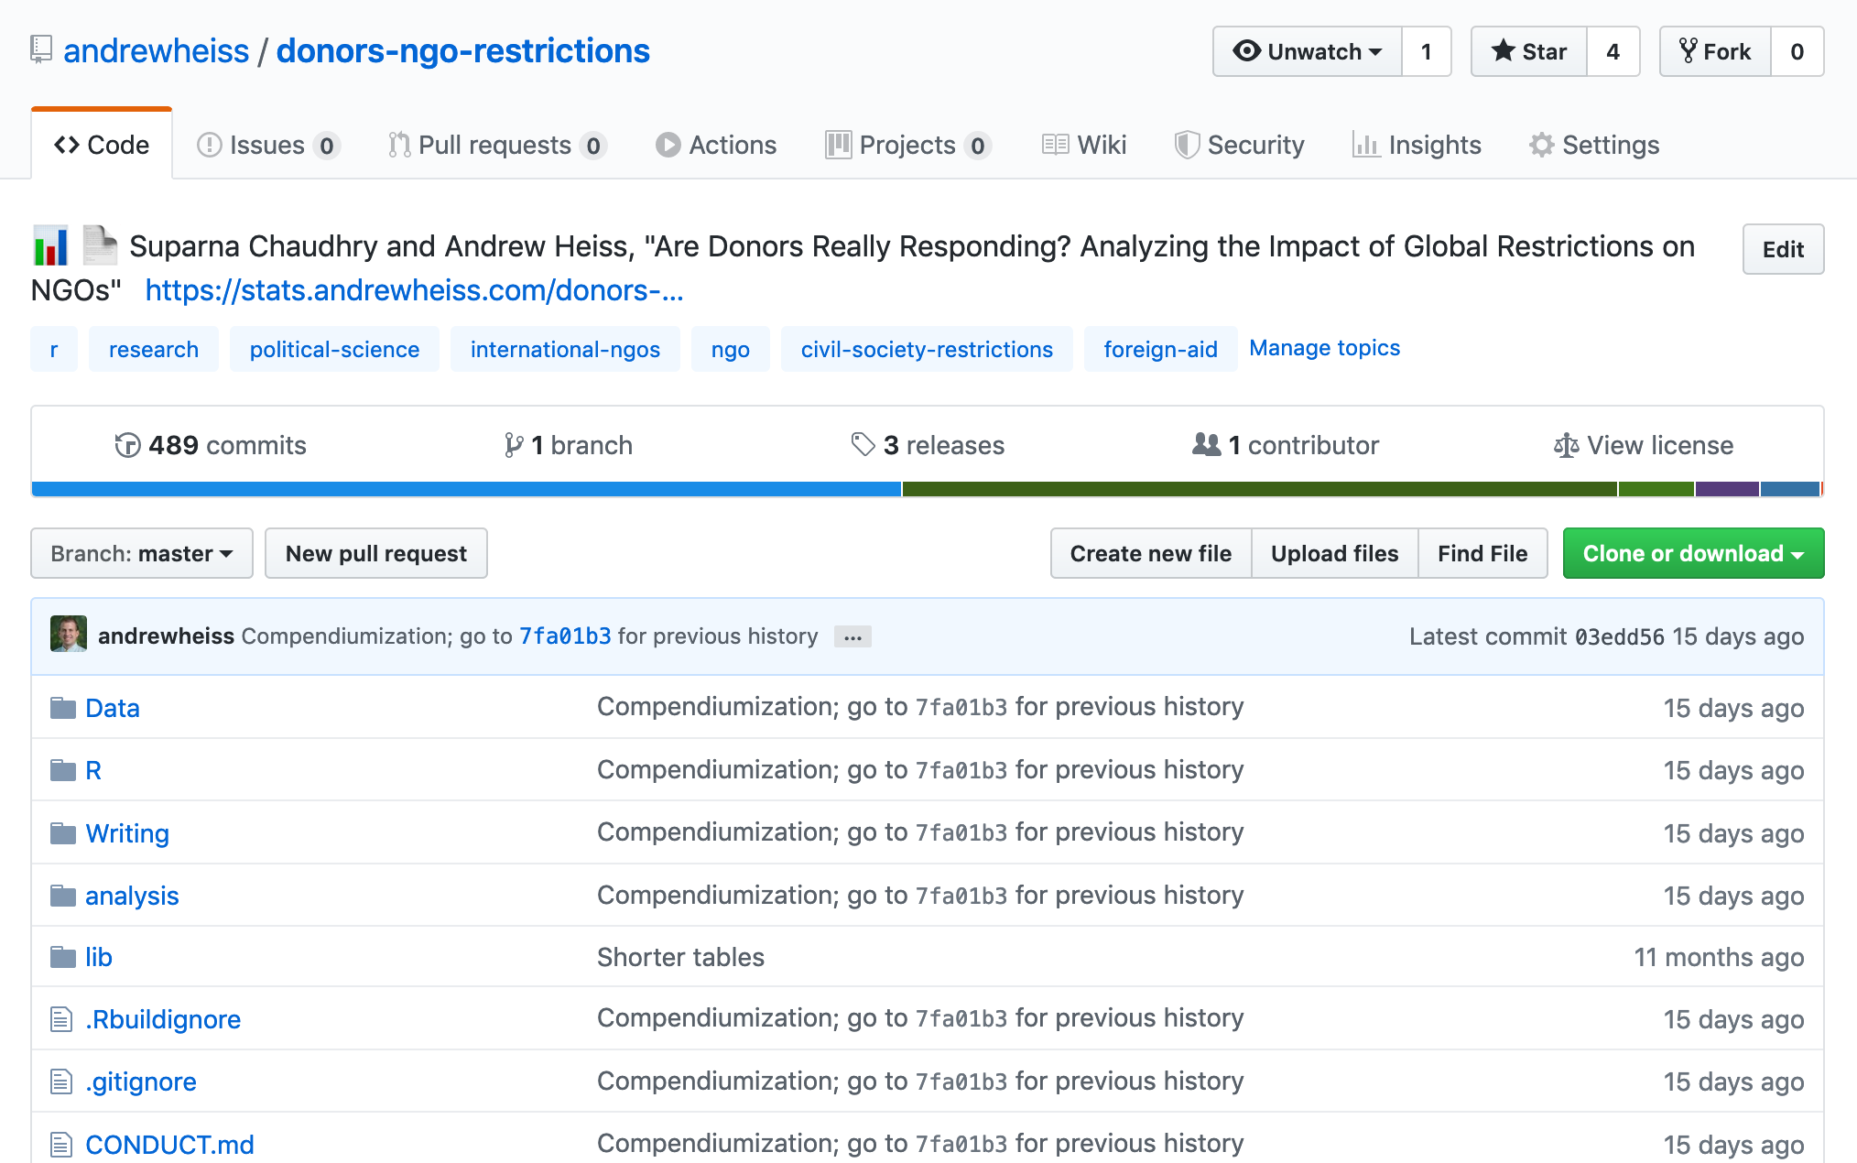

Slide 34
Moral of the story
Research is hard and alienating and lonely and (sometimes) crushing
Be open about failure and struggles
Embrace curiosity and share your work

